Slide 1

Catch-Up and the Curse of Oil
Thorvaldur Gylfason
University of Iceland and CESifo, Munich
See paper: https://www.ifo.de/DocDL/cesifo1_wp12448.pdf
Gylfi Zoega
University of Iceland, Birkbeck Business School,
and CESifo, Munich

Slide 2
True or false?
Ravaged by incessant conflict over its abundant natural resources, Congo (Dem. Rep.) famously remains mired in poverty
Remember Lumumba? See Soundtrack to a Coup d'Etat
Documentary film by Johan Grimonprez (2024), fabulous music
Congo is not alone
Iran, Iraq, Nigeria, Russia, Venezuela – the list is long, including even the U.S.
Two schools of thought about resources
Natural resources are – but of course! – good for growth
But wait: Natural resources can prove to be a mixed blessing

Slide 3
Mixed blessing story
It came as a counterintuitive bombshell surprise to many in mid-1990s when Sachs and Warner (NBER, 1995) removed the dust from an old idea:
Abundant natural resources can be a drag on economic growth
Many studies have since found empirical support for this still somewhat controversial finding:
Natural resources, if not well managed, tend through many different mechanisms to depress incomes and long-run growth …
… as well as democracy – just read Berlingske Tidende ☺

Slide 4
Ten mechanisms
Dutch disease (Gylfason, Herbertsson & Zoega, MD, 1999)
Rent seeking (Torvik, JDE, 2002)
Foreign interference (Belgium in Congo, US in Iran & Iraq, etc.)
Democracy (Ross, World Politics, 2001)
Education (Gylfason, EER, 2001)
Equality (Gylfason & Zoega, MIT Press, 2003)
External debt (Manzano & Rigobón, World Bank, 2007)
Corruption (Bhattacharyya & Hodler, EER, 2010)
Civil war (Ross, Princeton U. Press, 2012)
Foreign aid (Arezki et al., CESifo, 2024)

Slide 5
A bird´s eye view: Human development, democracy, and natural capital
Democracy 2021 and natural capital 1995-2018
HDI 2021 and natural capital
1995-2018
Source: Gylfason and Zoega, Elgar, 2026.

Slide 6
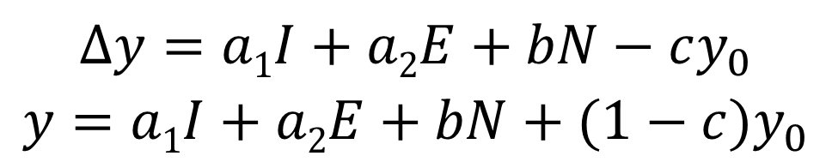
Empirical results: Round 1
Model
Per capita GDP growth depends on two controls, investment and education …
Share of gross domestic investment in GDP 1965-1998
Gross secondary-school enrolment rate, various periods
... as well as on
Share of natural capital in national wealth in 1994
Share of natural capital in total capital (physical, human, and natural capital)
Initial per capita GDP
To account for convergence
$$∆y=a1I+a2E+bN−cy_{0}$$
$y=a1I+a2E+bN+(1−c)y_{0}$

Slide 7
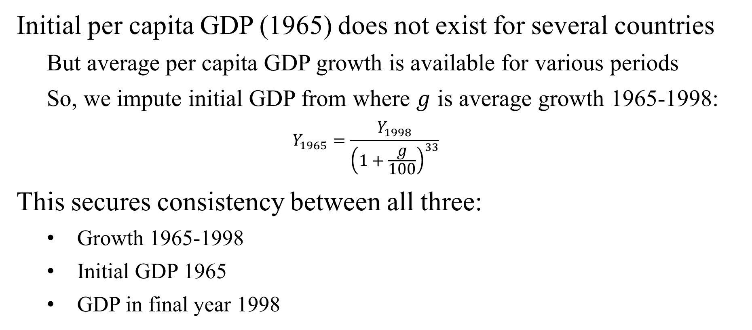
Consistency of data
Initial per capita GDP (1965) does not exist for several countries
But average per capita GDP growth is available for various periods
So, we impute initial GDP from where $g$ is average growth 1965-1998:
$$Y_{1965}=\frac{Y_{1998}}{{\left(1+\frac{g}{100}\right)}^{33}}$$
This secures consistency between all three:
Growth 1965-1998
Initial GDP 1965
GDP in final year 1998
Need to know only two of the three

Slide 8
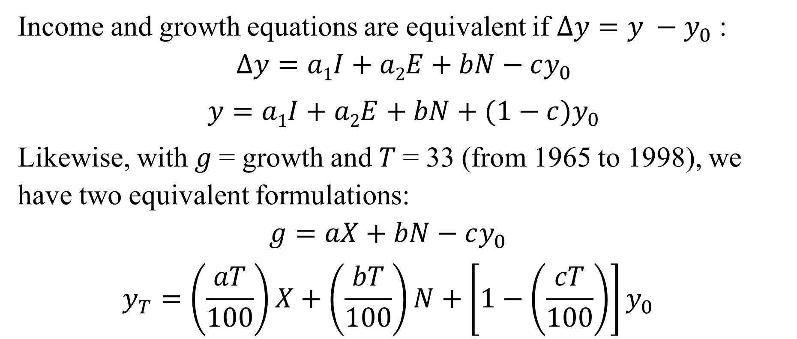
Two equivalent formulations
Income and growth equations are equivalent if $Δy=y −y_{0}$ :
$$∆y=a1I+a2E+bN−cy_{0}$$
$y=a1I+a2E+bN+(1−c)y_{0}$
Likewise, with $g$= growth and $T$= 33 (from 1965 to 1998), we have two equivalent formulations:
$$g=aX+bN−cy_{0}$$
$$y_{T}=\left(\frac{aT}{100}\right)X+\left(\frac{bT}{100}\right)N+\left[1−\left(\frac{cT}{100}\right)\right]y_{0}$$
One-to-one
correspondence

Slide 9
Table 1. Natural Capital and Economic Growth, 1965-1998
 | Initial GDP per capita (log) | Natural capital (% of national wealth) | Investment (% of GDP) | Secondary education (% of cohort) | R²
(1a) Growth of GDP per capita (%) | -1.573 (7.2) | -0.065 (4.5) | 0.083 (3.2) | 0.050 (5.9) | 0.67 N = 85
(2a) GDP per capita (log) | 0.492 (7.0) | -0.021 (4.6) | 0.027 (3.2) | 0.016 (5.9) | 0.91

Slide 10
Table 1. Natural Capital and Economic Growth, 1965-1998
 | Initial GDP per capita (log) | Natural capital (% of national wealth) | Investment (% of GDP) | Secondary education (% of cohort) | R²
(1a) Growth of GDP per capita (%) | -1.573 (7.2) | -0.065 (4.5) | 0.083 (3.2) | 0.050 (5.9) | 0.67 N = 85
(2a) GDP per capita (log) | 0.492 (7.0) | -0.021 (4.6) | 0.027 (3.2) | 0.016 (5.9) | 0.91

Slide 11
Table 1. Natural Capital and Economic Growth, 1965-1998
 | Initial GDP per capita (log) | Natural capital (% of national wealth) | Investment (% of GDP) | Secondary education (% of cohort) | R²
(1a) Growth of GDP per capita (%) | -1.573 (7.2) | -0.065 (4.5) | 0.083 (3.2) | 0.050 (5.9) | 0.67 N = 85
(2a) GDP per capita (log) | 0.492 (7.0) | -0.021 (4.6) | 0.027 (3.2) | 0.016 (5.9) | 0.91

Slide 12
Empirical results: Round 2
Model (as before)
Per capita GDP growth, now with PPP adjustment (not available in earlier sample), depends on two controls, investment and education …
Share of gross domestic investment in GDP 1990-2022
Gross secondary-school enrolment rate, various periods
… as well as on
Share of natural capital in national wealth 1995-2018
More broadly defined, including fossil fuel energy, minerals, agricultural, forests, fisheries, etc.
Alternatively: Share of natural resource rent in GDP 1990-2021
Initial per capita GDP 1990
No need to impute it as before

Slide 13
Table 2. Natural Capital and Economic Growth, 1990-2022
 | Initial GNI per capita (log) | Natural capital (% of national wealth) | Investment (% of GDP) | Secondary education (% of cohort) | R²
(1b) Growth of GNI per capita (%) | -1.591 (11.7) | -0.016 (1.85) | 0.075 (3.8) | 0.047 (7.2) | 0.60 N = 113
(2b) GNI per capita (log) | 0.502 (11.9) | -0.005 (1.87) | 0.023 (3.8) | 0.015 (7.3) | 0.91

Slide 14
Table 2. Natural Capital and Economic Growth, 1990-2022
 | Initial GNI per capita (log) | Natural capital (% of national wealth) | Investment (% of GDP) | Secondary education (% of cohort) | R²
(1b) Growth of GNI per capita (%) | -1.591 (11.7) | -0.016 (1.85) | 0.075 (3.8) | 0.047 (7.2) | 0.60 N = 113
(2b) GNI per capita (log) | 0.502 (11.9) | -0.005 (1.87) | 0.023 (3.8) | 0.015 (7.3) | 0.91

Slide 15
Table 2. Natural Capital and Economic Growth, 1990-2022
 | Initial GNI per capita (log) | Natural capital (% of national wealth) | Investment (% of GDP) | Secondary education (% of cohort) | R²
(1b) Growth of GNI per capita (%) | -1.591 (11.7) | -0.016 (1.85) | 0.075 (3.8) | 0.047 (7.2) | 0.60 N = 113
(2b) GNI per capita (log) | 0.502 (11.9) | -0.005 (1.87) | 0.023 (3.8) | 0.015 (7.3) | 0.91

Slide 16
Table 3. Natural Resource Rent and Economic Growth, 1990-2022
 | Initial GNI per capita (log) | Natural resource rent (% of GDP) | Investment (% of GDP) | Secondary education (% of cohort) | R²
(2c) Growth of GNI per capita (%) | -1.343 (9.7) | -0.029 (2.2) | 0.057 (3.1) | 0.042 (6.6) | 0.53 N = 138
(3c) GNI per capita (log) | 0.578 (13.4) | -0.009 (2.2) | 0.018 (3.1) | 0.013 (6.6) | 0.89
Now replace natural capital variable by natural resource rent
to increase sample size from 113 to 138

Slide 17
Table 3. Natural Resource Rent and Economic Growth, 1990-2022
 | Initial GNI per capita (log) | Natural resource rent (% of GDP) | Investment (% of GDP) | Secondary education (% of cohort) | R²
(2c) Growth of GNI per capita (%) | -1.343 (9.7) | -0.029 (2.2) | 0.057 (3.1) | 0.042 (6.6) | 0.53 N = 138
(3c) GNI per capita (log) | 0.578 (13.4) | -0.009 (2.2) | 0.018 (3.1) | 0.013 (6.6) | 0.89

Slide 18
Table 3. Natural Resource Rent and Economic Growth, 1990-2022
 | Initial GNI per capita (log) | Natural resource rent (% of GDP) | Investment (% of GDP) | Secondary education (% of cohort) | R²
(2c) Growth of GNI per capita (%) | -1.343 (9.7) | -0.029 (2.2) | 0.057 (3.1) | 0.042 (6.6) | 0.53 N = 138
(3c) GNI per capita (log) | 0.578 (13.4) | -0.009 (2.2) | 0.018 (3.1) | 0.013 (6.6) | 0.89

Slide 19
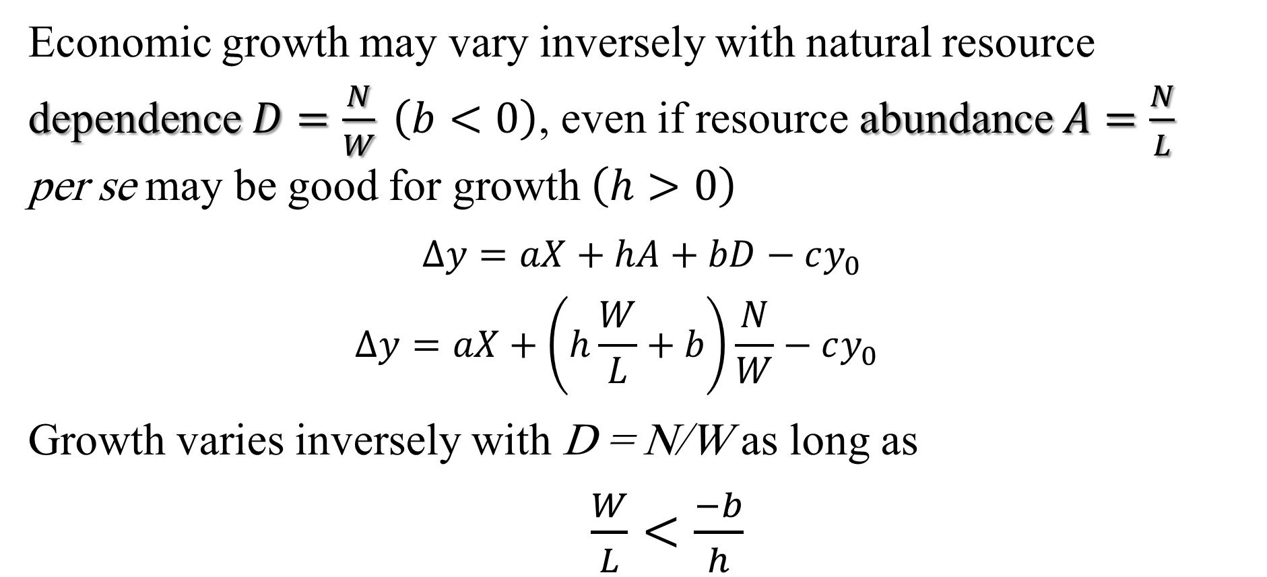
Abundance vs. dependence
Economic growth may vary inversely with natural resource dependence $D=\frac{N}{W} \left(b<0\right)$, even if resource abundance $A=\frac{N}{L}$ per se may be good for growth $\left(h>0\right)$
$∆y=aX+hA+bD−cy_{0}$
$$∆y=aX+\left(h\frac{W}{L}+b\right)\frac{N}{W}−cy_{0}$$
Growth varies inversely with D = N/W as long as
$\frac{W}{L}<\frac{−b}{h}$

Slide 20
Table 3. Abundance, Dependence, and Growth
 | Initial per capita income (log) | Natural capital (% of national wealth) | Natural capital per person (constant US$) | Investment (% of GDP) | Secondary education (% of cohort) | R²
1965-1998 (85 countries)
(3a) GDP per capita (log) | 0.450 (6.3) | -0.030 (6.0) | 0.018 (3.0) | 0.001 (2.9) | 0.015 (5.4) | 0.92
(3b) Growth of GDP per capita (%) | -1.700 (7.7) | -0.092 (5.9) | 0.056 (3.0) | 0.004 (2.9) | 0.045 (5.3) | 0.69
1990-2022 (113 countries)
(3c) GNI per capita (log) | 0.416 (8.1) | -1.156 (2.2) | 0.001 (1.2) | 0.024 (3.8) | 0.015 (7.3) | 0.91
(3d) Growth of GNI per capita (%) | -1.678 (11.1) | -0.020 (2.2) | 0.004 (1.3) | 0.076 (3.9) | 0.047 (7.3) | 0.60

Slide 21
Abundance vs. dependence
First sample 1965-1998
The net effect of an increase in natural capital share on income and growth declines with wealth per person
It remains negative as long as per capita national wealth is less than USD 164,000 (= 0.092/0.056*10⁵)
This is roughly the cut-off point between the 20 industrial countries and the 65 developing countries in the first sample

Slide 22
Table 3. Abundance, Dependence, and Growth
Again
 | Initial per capita income (log) | Natural capital (% of national wealth) | Natural capital per person (constant US$) | Investment (% of GDP) | Secondary education (% of cohort) | R²
1965-1998 (85 countries)
(3a) GDP per capita (log) | 0.450 (6.3) | -0.030 (6.0) | 0.018 (3.0) | 0.001 (2.9) | 0.015 (5.4) | 0.92
(3b) Growth of GDP per capita (%) | -1.700 (7.7) | -0.092 (5.9) | 0.056 (3.0) | 0.004 (2.9) | 0.045 (5.3) | 0.69
1990-2022 (113 countries)
(3c) GNI per capita (log) | 0.416 (8.1) | -1.156 (2.2) | 0.001 (1.2) | 0.024 (3.8) | 0.015 (7.3) | 0.91
(3d) Growth of GNI per capita (%) | -1.678 (11.1) | -0.020 (2.2) | 0.004 (1.3) | 0.076 (3.9) | 0.047 (7.3) | 0.60

Slide 23
Abundance vs. dependence
Second sample 1990-2022
Again, the net effect of an increase in natural capital share on income and growth declines with wealth per person
It remains negative as long as per capita national wealth is less than USD 500,000 (= 0.020/0.004*10⁵)
This is roughly the cut-off point between the 98 developing countries with total per capita wealth below USD 500,000, and 16 high-income countries with total per capita wealth above that threshold

Slide 24
Conclusion
An increase in natural capital intensity tends to depress incomes and discourage long-run growth in low-income countries …
… but may increase incomes and growth in some high-income countries, especially democracies
A natural-resource discovery, if misappropriated or if the rent from it is mismanaged, can set in motion economic and political forces that conspire to reduce the country´s subsequent growth …
… which may ultimately reduce the level of per capita GDP below the level it would have attained without the resource discovery

Slide 25
Conclusion
If you were members of – e.g., married into – the Saudi Royal family, would you favor democracy? ☺
Economic growth depends primarily on the quality of institutions and presupposes the rule of law with limited rent-seeking …
… all of which are exacerbated by abundant natural resource discoveries that precede the establishment of a rule-based state
The End

