Slide 1
Catch-Up and the Curse of Oil
Thorvaldur Gylfason
University of Iceland
and CESifo, Munich
See paper: https://www.ifo.de/DocDL/cesifo1_wp12448.pdf
Gylfi Zoega
University of Iceland,
Birkbeck Business School, and CESifo, Munich

Slide 2
True or false?
Ravaged by incessant conflict over its abundant natural resources,
Congo (Dem. Rep.) famously remains mired in poverty
  Remember Lumumba? See Soundtrack to a Coup d'Etat
    Documentary film by Johan Grimonprez (2024)
  Congo is not alone
    Iran, Iraq, Nigeria, Russia, Venezuela, the list is long
Two schools of thought about resources
  Natural resources are – but of course! – good for growth
  But wait: Natural resources may be a mixed blessing

Slide 3
Mixed blessing story
It came as a counterintuitive bombshell surprise to many in mid-1990s when Sachs and Warner (NBER, 1995) removed the dust from an old idea:
  Abundant natural resources can be a drag on economic growth
Many studies have since found empirical support for this still somewhat controversial finding:
  Natural resources, if not well managed, tend to depress incomes and growth through many different mechanisms

Slide 4
Ten mechanisms
  Dutch disease (Gylfason, Herbertsson & Zoega, MD, 1999)
  Rent seeking (Torvik, JDE, 2002)
  Foreign interference (Belgium in Congo, US in Iran & Iraq, etc.)
  Democracy (Ross, World Politics, 2001)
  Education (Gylfason, EER, 2001)
  Equality (Gylfason & Zoega, MIT Press, 2003)
  External debt (Manzano & Rigobón, World Bank, 2007)
  Corruption (Bhattacharyya & Hodler, EER, 2010)
  Civil war (Ross, Princeton U. Press, 2012)
  Foreign aid (Arezki et al., CESifo, 2024)

Slide 5
A bird´s eye view: Human development, democracy, and natural capital
Democracy 2021 and natural capital 1995-2018
HDI 2021 and natural capital
1995-2018
Source: Gylfason and Zoega, Elgar, 2026.

Slide 6
Our three-pronged approach
1. Importance of catch-up, i.e., convergence
  Risk of misspecification if left out of regression models
2. Distinction between abundance vs. dependence
  Some countries have abundant natural resources without really depending on them
3. Attempt to quantify the cut-off point between blessing vs. curse
  Find the level of per capita income at which natural resources cease to be a drag on growth

Slide 7
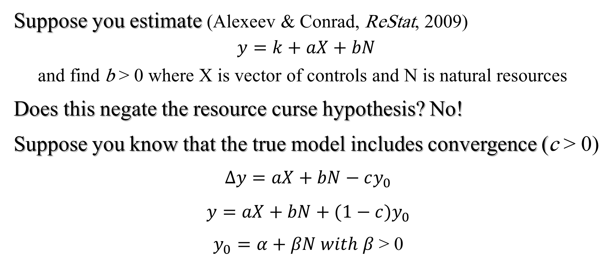
Importance of initial income
Suppose you estimate (Alexeev & Conrad, ReStat, 2009)
$$y=k+aX+bN$$
  and find b > 0 where X is vector of controls and N is natural resources
Does this negate the resource curse hypothesis? No!
Suppose you know that the true model includes convergence (c > 0)
$∆y=aX+bN−cy_{0}$
$y=aX+bN+(1−c)y_{0}$
$y_{0}=α+βN with β$> 0

Slide 8
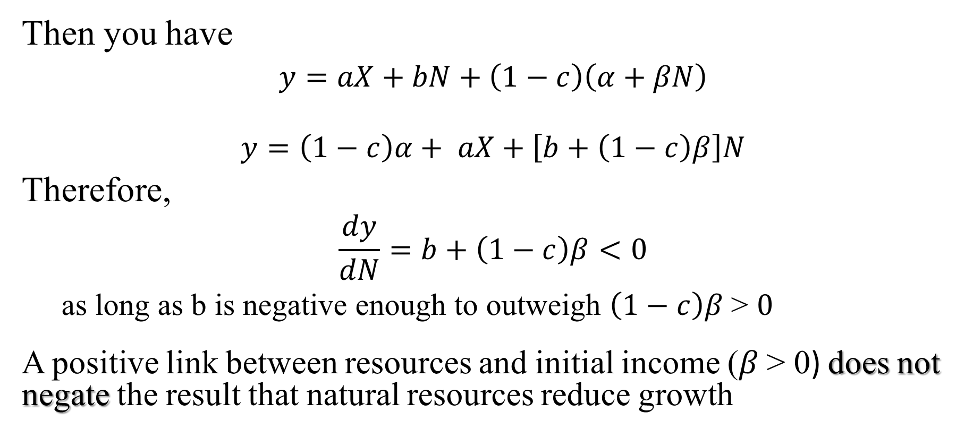
Importance of initial income
Then you have
$y=aX+bN+\left(1−c\right)\left(α+βN\right)$
$$y=\left(1−c\right)α+ aX+\left[b+\left(1−c\right)β\right]N$$
Therefore,
$$\frac{dy}{dN}=b+\left(1−c\right)β<0$$
  as long as b is negative enough to outweigh $\left(1−c\right)β \text{>} 0$
A positive link between resources and initial income ($β$> 0) does not negate the result that natural resources reduce growth

Slide 9
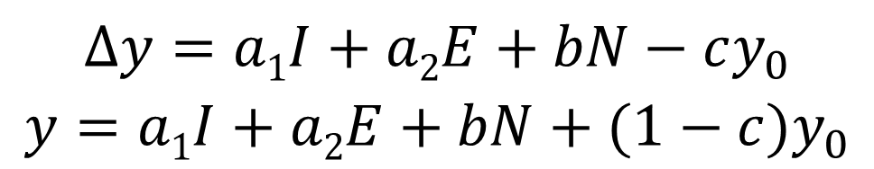
Empirical results: Round 1
Model
  Per capita GDP growth depends on two controls, investment and education:
    Share of gross domestic investment in GDP 1965-1998
    Gross secondary-school enrolment rate, various periods
  As well as on:
    Share of natural capital in national wealth in 1994
      Share of natural capital in total capital (physical, human, and natural capital)
    Initial per capita GDP
$$∆y=a1I+a2E+bN−cy_{0}$$
$y=a1I+a2E+bN+(1−c)y_{0}$

Slide 10
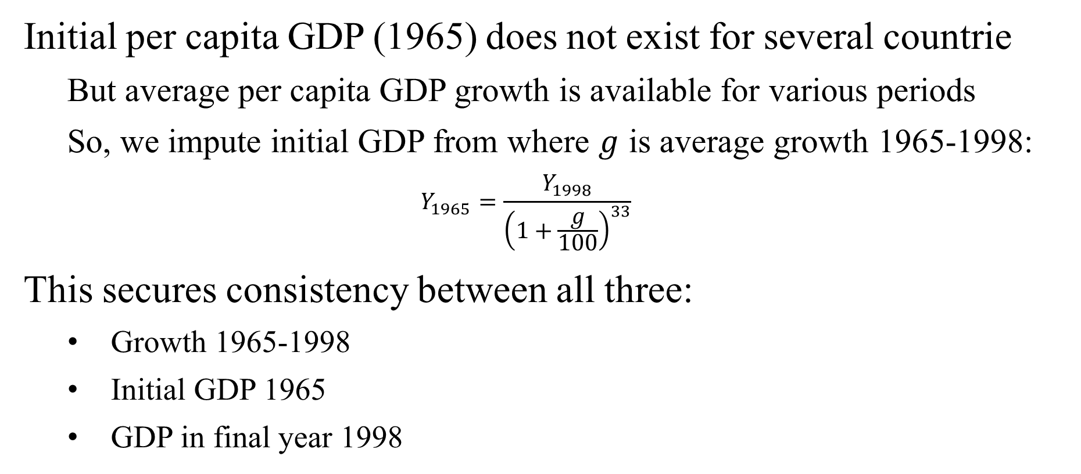
Consistency of data
Initial per capita GDP (1965) does not exist for several countrie
  But average per capita GDP growth is available for various periods
  So, we impute initial GDP from where $g$ is average growth 1965-1998:
  $$Y_{1965}=\frac{Y_{1998}}{{\left(1+\frac{g}{100}\right)}^{33}}$$
This secures consistency between all three:
  Growth 1965-1998
  Initial GDP 1965
  GDP in final year 1998

Slide 11
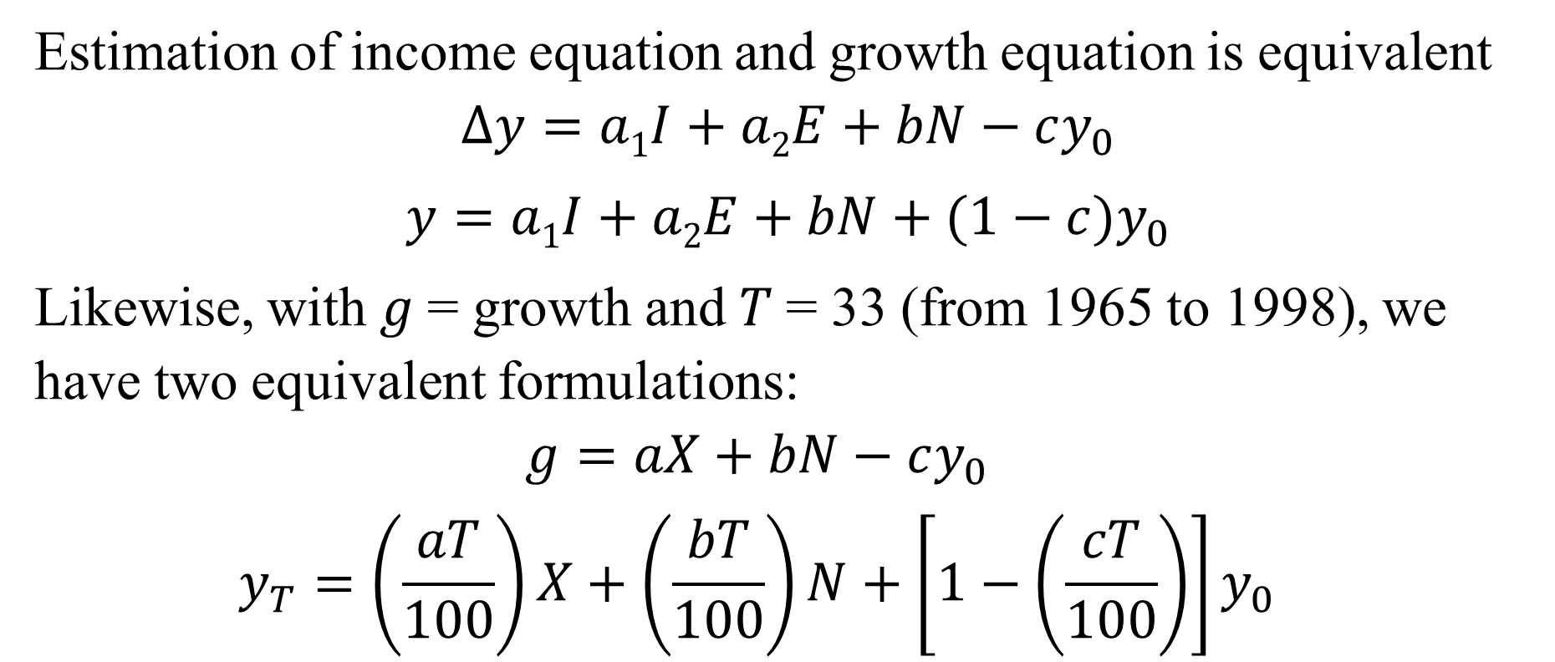
Two equivalent formulations
Estimation of income equation and growth equation is equivalent
$$∆y=a1I+a2E+bN−cy_{0}$$
$y=a1I+a2E+bN+(1−c)y_{0}$
Likewise, with $g$= growth and $T$= 33 (from 1965 to 1998), we have two equivalent formulations:
  $$g=aX+bN−cy_{0}$$
  $$y_{T}=\left(\frac{aT}{100}\right)X+\left(\frac{bT}{100}\right)N+\left[1−\left(\frac{cT}{100}\right)\right]y_{0}$$

Slide 12
Table 1. Natural Capital and Economic Growth, 1965-1998
 | Initial GDP per capita (log) | Natural capital (% of national wealth) | Investment (% of GDP) | Secondary education (% of cohort) | R²
(1a) GDP per capita (log) |  | -0.022 (3.9) | 0.006 (0.6) | 0.032 (15.4) | 0.86
(2a) Growth of GDP per capita (%) | -1.573 (7.2) | -0.065 (4.5) | 0.083 (3.2) | 0.050 (5.9) | 0.67
(3a) GDP per capita (log) | 0.492 (7.0) | -0.021 (4.6) | 0.027 (3.2) | 0.016 (5.9) | 0.91
(4a) Initial GDP per capita (log) |  | -0.043 (4.4) |  |  | 0.19 N = 113

Slide 13
Table 1. Natural Capital and Economic Growth, 1965-1998
 | Initial GDP per capita (log) | Natural capital (% of national wealth) | Investment (% of GDP) | Secondary education (% of cohort) | R²
(1a) GDP per capita (log) |  | -0.022 (3.9) | 0.006 (0.6) | 0.032 (15.4) | 0.86
(2a) Growth of GDP per capita (%) | -1.573 (7.2) | -0.065 (4.5) | 0.083 (3.2) | 0.050 (5.9) | 0.67
(3a) GDP per capita (log) | 0.492 (7.0) | -0.021 (4.6) | 0.027 (3.2) | 0.016 (5.9) | 0.91
(4a) Initial GDP per capita (log) |  | -0.043 (4.4) |  |  | 0.19 N = 113

Slide 14
Table 1. Natural Capital and Economic Growth, 1965-1998
 | Initial GDP per capita (log) | Natural capital (% of national wealth) | Investment (% of GDP) | Secondary education (% of cohort) | R²
(1a) GDP per capita (log) |  | -0.022 (3.9) | 0.006 (0.6) | 0.032 (15.4) | 0.86
(2a) Growth of GDP per capita (%) | -1.573 (7.2) | -0.065 (4.5) | 0.083 (3.2) | 0.050 (5.9) | 0.67
(3a) GDP per capita (log) | 0.492 (7.0) | -0.021 (4.6) | 0.027 (3.2) | 0.016 (5.9) | 0.91
(4a) Initial GDP per capita (log) |  | -0.043 (4.4) |  |  | 0.19 N = 113

Slide 15
Table 1. Natural Capital and Economic Growth, 1965-1998
 | Initial GDP per capita (log) | Natural capital (% of national wealth) | Investment (% of GDP) | Secondary education (% of cohort) | R²
(1a) GDP per capita (log) |  | -0.022 (3.9) | 0.006 (0.6) | 0.032 (15.4) | 0.86
(2a) Growth of GDP per capita (%) | -1.573 (7.2) | -0.065 (4.5) | 0.083 (3.2) | 0.050 (5.9) | 0.67
(3a) GDP per capita (log) | 0.492 (7.0) | -0.021 (4.6) | 0.027 (3.2) | 0.016 (5.9) | 0.91
(4a) Initial GDP per capita (log) |  | -0.043 (4.4) |  |  | 0.19 N = 113

Slide 16
Table 1. Natural Capital and Economic Growth, 1965-1998
 | Initial GDP per capita (log) | Natural capital (% of national wealth) | Investment (% of GDP) | Secondary education (% of cohort) | R²
(1a) GDP per capita (log) |  | -0.022 (3.9) | 0.006 (0.6) | 0.032 (15.4) | 0.86
(2a) Growth of GDP per capita (%) | -1.573 (7.2) | -0.065 (4.5) | 0.083 (3.2) | 0.050 (5.9) | 0.67
(3a) GDP per capita (log) | 0.492 (7.0) | -0.021 (4.6) | 0.027 (3.2) | 0.016 (5.9) | 0.91
(4a) Initial GDP per capita (log) |  | -0.043 (4.4) |  |  | 0.19 N = 113

Slide 17
Table 1. Natural Capital and Economic Growth, 1965-1998
 | Initial GDP per capita (log) | Natural capital (% of national wealth) | Investment (% of GDP) | Secondary education (% of cohort) | R²
(1a) GDP per capita (log) |  | -0.022 (3.9) | 0.006 (0.6) | 0.032 (15.4) | 0.86
(2a) Growth of GDP per capita (%) | -1.573 (7.2) | -0.065 (4.5) | 0.083 (3.2) | 0.050 (5.9) | 0.67
(3a) GDP per capita (log) | 0.492 (7.0) | -0.021 (4.6) | 0.027 (3.2) | 0.016 (5.9) | 0.91
(4a) Initial GDP per capita (log) |  | -0.043 (4.4) |  |  | 0.19 N = 113

Slide 18
Empirical results: Round 2
Model (as before)
  Per capita GDP growth, now with PPP adjustment (not available in earlier sample), depends on two controls, investment and education:
    Share of gross domestic investment in GDP 1990-2022
    Gross secondary-school enrolment rate, various periods
  As well as on:
    Share of natural capital in national wealth 1995-2018
      More broadly defined, including fossil fuel energy, minerals, agricultural, forests, fisheries, etc.
      Alternatively: Share of natural resource rent in GDP 1990-2021
    Initial per capita GDP 1990
      No need to impute it as before

Slide 19
Table 2. Natural Capital and Economic Growth, 1990-2022
 | Initial GNI per capita (log) | Natural capital (% of national wealth) | Investment (% of GDP) | Secondary education (% of cohort) | R²
(1b) GNI per capita (log) |  | -0.004 (0.95) | 0.021 (2.3) | 0.031 (14.3) | 0.79
(2b) Growth of GNI per capita (%) | -1.591 (11.7) | -0.016 (1.85) | 0.075 (3.8) | 0.047 (7.2) | 0.60
(3b) GNI per capita (log) | 0.502 (11.9) | -0.005 (1.87) | 0.023 (3.8) | 0.015 (7.3) | 0.91
(4b) Initial GNI per capita (log) |  | -0.036 (5.9) |  |  | 0.24 N = 113

Slide 20
Table 2. Natural Capital and Economic Growth, 1990-2022
 | Initial GNI per capita (log) | Natural capital (% of national wealth) | Investment (% of GDP) | Secondary education (% of cohort) | R²
(1b) GNI per capita (log) |  | -0.004 (0.95) | 0.021 (2.3) | 0.031 (14.3) | 0.79
(2b) Growth of GNI per capita (%) | -1.591 (11.7) | -0.016 (1.85) | 0.075 (3.8) | 0.047 (7.2) | 0.60
(3b) GNI per capita (log) | 0.502 (11.9) | -0.005 (1.87) | 0.023 (3.8) | 0.015 (7.3) | 0.91
(4b) Initial GNI per capita (log) |  | -0.036 (5.9) |  |  | 0.24 N = 113

Slide 21
Table 2. Natural Capital and Economic Growth, 1990-2022
 | Initial GNI per capita (log) | Natural capital (% of national wealth) | Investment (% of GDP) | Secondary education (% of cohort) | R²
(1b) GNI per capita (log) |  | -0.004 (0.95) | 0.021 (2.3) | 0.031 (14.3) | 0.79
(2b) Growth of GNI per capita (%) | -1.591 (11.7) | -0.016 (1.85) | 0.075 (3.8) | 0.047 (7.2) | 0.60
(3b) GNI per capita (log) | 0.502 (11.9) | -0.005 (1.87) | 0.023 (3.8) | 0.015 (7.3) | 0.91
(4b) Initial GNI per capita (log) |  | -0.036 (5.9) |  |  | 0.24 N = 113

Slide 22
Table 2. Natural Capital and Economic Growth, 1990-2022
 | Initial GNI per capita (log) | Natural capital (% of national wealth) | Investment (% of GDP) | Secondary education (% of cohort) | R²
(1b) GNI per capita (log) |  | -0.004 (0.95) | 0.021 (2.3) | 0.031 (14.3) | 0.79
(2b) Growth of GNI per capita (%) | -1.591 (11.7) | -0.016 (1.85) | 0.075 (3.8) | 0.047 (7.2) | 0.60
(3b) GNI per capita (log) | 0.502 (11.9) | -0.005 (1.87) | 0.023 (3.8) | 0.015 (7.3) | 0.91
(4b) Initial GNI per capita (log) |  | -0.036 (5.9) |  |  | 0.24 N = 113

Slide 23
Table 2. Natural Capital and Economic Growth, 1990-2022
 | Initial GNI per capita (log) | Natural capital (% of national wealth) | Investment (% of GDP) | Secondary education (% of cohort) | R²
(1b) GNI per capita (log) |  | -0.004 (0.95) | 0.021 (2.3) | 0.031 (14.3) | 0.79
(2b) Growth of GNI per capita (%) | -1.591 (11.7) | -0.016 (1.85) | 0.075 (3.8) | 0.047 (7.2) | 0.60
(3b) GNI per capita (log) | 0.502 (11.9) | -0.005 (1.87) | 0.023 (3.8) | 0.015 (7.3) | 0.91
(4b) Initial GNI per capita (log) |  | -0.036 (5.9) |  |  | 0.24 N = 113

Slide 24
Table 2. Natural Capital and Economic Growth, 1990-2022
 | Initial GNI per capita (log) | Natural capital (% of national wealth) | Investment (% of GDP) | Secondary education (% of cohort) | R²
(1b) GNI per capita (log) |  | -0.004 (0.95) | 0.021 (2.3) | 0.031 (14.3) | 0.79
(2b) Growth of GNI per capita (%) | -1.591 (11.7) | -0.016 (1.85) | 0.075 (3.8) | 0.047 (7.2) | 0.60
(3b) GNI per capita (log) | 0.502 (11.9) | -0.005 (1.87) | 0.023 (3.8) | 0.015 (7.3) | 0.91
(4b) Initial GNI per capita (log) |  | -0.036 (5.9) |  |  | 0.24 N = 113

Slide 25
Table 3. Natural Resource Rent and Economic Growth, 1990-2022
 | Initial GNI per capita (log) | Natural resource rent (% of GDP) | Investment (% of GDP) | Secondary education (% of cohort) | R²
(1c) GNI per capita (log) |  | -0.011 (1.85) | 0.008 (0.9) | 0.034 (17.6) | 0.73
(2c) Growth of GNI per capita (%) | -1.343 (9.7) | -0.029 (2.2) | 0.057 (3.1) | 0.042 (6.6) | 0.53
(3c) GNI per capita (log) | 0.578 (13.4) | -0.009 (2.2) | 0.018 (3.1) | 0.013 (6.6) | 0.89
(4c) Initial GNI per capita (log) |  | -0.013 (1.2) |  |  | 0.01 N = 138

Slide 26
Table 3. Natural Resource Rent and Economic Growth, 1990-2022
 | Initial GNI per capita (log) | Natural resource rent (% of GDP) | Investment (% of GDP) | Secondary education (% of cohort) | R²
(1c) GNI per capita (log) |  | -0.011 (1.85) | 0.008 (0.9) | 0.034 (17.6) | 0.73
(2c) Growth of GNI per capita (%) | -1.343 (9.7) | -0.029 (2.2) | 0.057 (3.1) | 0.042 (6.6) | 0.53
(3c) GNI per capita (log) | 0.578 (13.4) | -0.009 (2.2) | 0.018 (3.1) | 0.013 (6.6) | 0.89
(4c) Initial GNI per capita (log) |  | -0.013 (1.2) |  |  | 0.01 N = 138

Slide 27
Table 3. Natural Resource Rent and Economic Growth, 1990-2022
 | Initial GNI per capita (log) | Natural resource rent (% of GDP) | Investment (% of GDP) | Secondary education (% of cohort) | R²
(1c) GNI per capita (log) |  | -0.011 (1.85) | 0.008 (0.9) | 0.034 (17.6) | 0.73
(2c) Growth of GNI per capita (%) | -1.343 (9.7) | -0.029 (2.2) | 0.057 (3.1) | 0.042 (6.6) | 0.53
(3c) GNI per capita (log) | 0.578 (13.4) | -0.009 (2.2) | 0.018 (3.1) | 0.013 (6.6) | 0.89
(4c) Initial GNI per capita (log) |  | -0.013 (1.2) |  |  | 0.01 N = 138

Slide 28
Table 3. Natural Resource Rent and Economic Growth, 1990-2022
 | Initial GNI per capita (log) | Natural resource rent (% of GDP) | Investment (% of GDP) | Secondary education (% of cohort) | R²
(1c) GNI per capita (log) |  | -0.011 (1.85) | 0.008 (0.9) | 0.034 (17.6) | 0.73
(2c) Growth of GNI per capita (%) | -1.343 (9.7) | -0.029 (2.2) | 0.057 (3.1) | 0.042 (6.6) | 0.53
(3c) GNI per capita (log) | 0.578 (13.4) | -0.009 (2.2) | 0.018 (3.1) | 0.013 (6.6) | 0.89
(4c) Initial GNI per capita (log) |  | -0.013 (1.2) |  |  | 0.01 N = 138

Slide 29
Table 3. Natural Resource Rent and Economic Growth, 1990-2022
 | Initial GNI per capita (log) | Natural resource rent (% of GDP) | Investment (% of GDP) | Secondary education (% of cohort) | R²
(1c) GNI per capita (log) |  | -0.011 (1.85) | 0.008 (0.9) | 0.034 (17.6) | 0.73
(2c) Growth of GNI per capita (%) | -1.343 (9.7) | -0.029 (2.2) | 0.057 (3.1) | 0.042 (6.6) | 0.53
(3c) GNI per capita (log) | 0.578 (13.4) | -0.009 (2.2) | 0.018 (3.1) | 0.013 (6.6) | 0.89
(4c) Initial GNI per capita (log) |  | -0.013 (1.2) |  |  | 0.01 N = 138

Slide 30
Table 3. Natural Resource Rent and Economic Growth, 1990-2022
 | Initial GNI per capita (log) | Natural resource rent (% of GDP) | Investment (% of GDP) | Secondary education (% of cohort) | R²
(1c) GNI per capita (log) |  | -0.011 (1.85) | 0.008 (0.9) | 0.034 (17.6) | 0.73
(2c) Growth of GNI per capita (%) | -1.343 (9.7) | -0.029 (2.2) | 0.057 (3.1) | 0.042 (6.6) | 0.53
(3c) GNI per capita (log) | 0.578 (13.4) | -0.009 (2.2) | 0.018 (3.1) | 0.013 (6.6) | 0.89
(4c) Initial GNI per capita (log) |  | -0.013 (1.2) |  |  | 0.01 N = 138

Slide 31
Table 4. Economic Freedom, 1995-2025
 | Natural capital (% of national wealth) | Natural resource rent (% of GDP) | Secondary education (% of cohort) | Investment (% of GDP) | R²
Economic freedom (N = 113) | -14.607 (2.7) |  | 0.153 (5.0) |  | 0.44
Economic freedom (N = 113) | -14.782 (2.7) |  | 0.154 (5.0) | -0.066 (0.51) | 0.44
Economic freedom (N = 132) |  | -0.274 (3.9) | 0.181 (7.9) |  | 0.49
Economic freedom (N = 132) |  | -0.273 (3.8) | 0.181 (7.8) | -0.020 (0.19) | 0.49

Slide 32
Table 4. Economic Freedom, 1995-2025
 | Natural capital (% of national wealth) | Natural resource rent (% of GDP) | Secondary education (% of cohort) | Investment (% of GDP) | R²
Economic freedom (N = 113) | -14.607 (2.7) |  | 0.153 (5.0) |  | 0.44
Economic freedom (N = 113) | -14.782 (2.7) |  | 0.154 (5.0) | -0.066 (0.51) | 0.44
Economic freedom (N = 132) |  | -0.274 (3.9) | 0.181 (7.9) |  | 0.49
Economic freedom (N = 132) |  | -0.273 (3.8) | 0.181 (7.8) | -0.020 (0.19) | 0.49

Slide 33
Table 5. Abundance, Dependence, and Growth
 | Initial per capita income (log) | Natural capital (% of national wealth) | Natural capital per person (constant US$) | Investment (% of GDP) | Secondary education (% of cohort) | R²
1965-1998 (85 countries)
(14a) GDP per capita (log) | 0.450 (6.3) | -0.030 (6.0) | 0.018 (3.0) | 0.001 (2.9) | 0.015 (5.4) | 0.92
(14b) Growth of GDP per capita (%) | -1.700 (7.7) | -0.092 (5.9) | 0.056 (3.0) | 0.004 (2.9) | 0.045 (5.3) | 0.69
1990-2022 (113 countries)
(14c) GNI per capita (log) | 0.416 (8.1) | -1.156 (2.2) | 0.001 (1.2) | 0.024 (3.8) | 0.015 (7.3) | 0.91
(14d) Growth of GNI per capita (%) | -1.678 (11.1) | -0.020 (2.2) | 0.004 (1.3) | 0.076 (3.9) | 0.047 (7.3) | 0.60

Slide 34
Table 5. Abundance, Dependence, and Growth
 | Initial per capita income (log) | Natural capital (% of national wealth) | Natural capital per person (constant US$) | Investment (% of GDP) | Secondary education (% of cohort) | R²
1965-1998 (85 countries)
(14a) GDP per capita (log) | 0.450 (6.3) | -0.030 (6.0) | 0.018 (3.0) | 0.001 (2.9) | 0.015 (5.4) | 0.92
(14b) Growth of GDP per capita (%) | -1.700 (7.7) | -0.092 (5.9) | 0.056 (3.0) | 0.004 (2.9) | 0.045 (5.3) | 0.69
1990-2022 (113 countries)
(14c) GNI per capita (log) | 0.416 (8.1) | -1.156 (2.2) | 0.001 (1.2) | 0.024 (3.8) | 0.015 (7.3) | 0.91
(14d) Growth of GNI per capita (%) | -1.678 (11.1) | -0.020 (2.2) | 0.004 (1.3) | 0.076 (3.9) | 0.047 (7.3) | 0.60

Slide 35
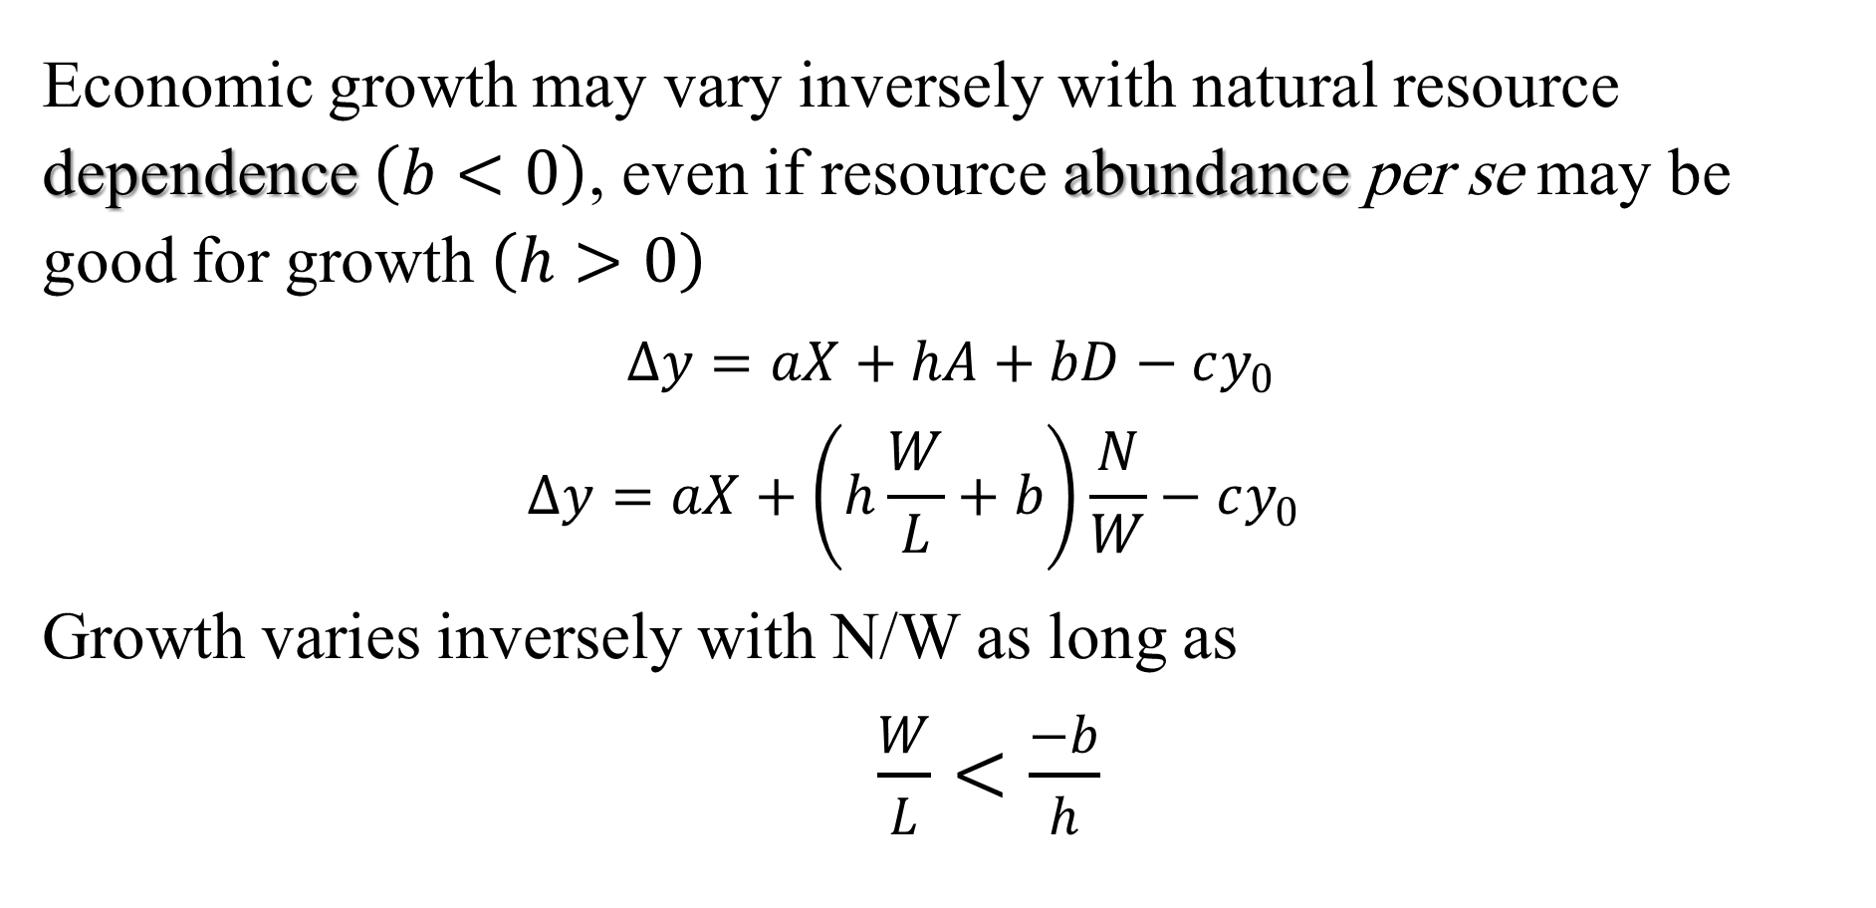
Abundance vs. dependence
Economic growth may vary inversely with natural resource dependence $\left(b<0\right)$, even if resource abundance per se may be good for growth $\left(h>0\right)$
$∆y=aX+hA+bD−cy_{0}$
  $$∆y=aX+\left(h\frac{W}{L}+b\right)\frac{N}{W}−cy_{0}$$
Growth varies inversely with N/W as long as
  $\frac{W}{L}<\frac{−b}{h}$

Slide 36
Abundance vs. dependence
First sample 1965-1998
  The net effect of an increase in natural capital share on income and growth declines with wealth per person
  It remains negative as long as per capita national wealth is less than USD 164,000 (= 0.092/0.056*10⁵)
  This is roughly the cut-off point between the 20 industrial countries and the 65 developing countries in the first sample

Slide 37
Abundance vs. dependence
Second sample 1990-2022
  Again, the net effect of an increase in natural capital share on income and growth declines with wealth per person
  It remains negative as long as per capita national wealth is less than USD 500,000 (= 0.020/0.004*10⁵)
  This is roughly the cut-off point between the 98 developing countries with total per capita wealth below USD 500,000, and 16 high-income countries with total per capita wealth above that threshold

Slide 38
Conclusion
An increase in natural capital intensity tends to depress incomes and discourage growth in low-income countries …
  but may increase incomes and growth in some high-income countries, especially democracies
A natural-resource discovery, if misappropriated or if the rent from it is mismanaged, can set in motion economic and political forces that conspire to reduce the country´s subsequent growth …
  which may ultimately reduce the level of per capita GDP below the level it would have attained without the resource discovery

Slide 39
Conclusion
Economic growth depends primarily on the quality of institutions and the rule of law with limited rent-seeking, all of which are exacerbated by abundant natural resource discoveries that precede the establishment of a rule-based state
The End

Slide 40
Table 6. GDP per capita in
Six Resource-rich Countries, 2024
 | Nominal (USD) | PPP (Int$)
Angola | 2,666 | 10,119
Congo (Dem. Rep.) | 649 | 1,821
Congo (Rep.) | 2,482 | 7,026
Nigeria | 1,084 | 9,087
Sierra Leone | 807 | 3,522
Sudan | 985 | 2,116

Slide 41
Table 7. GDP per capita in
Six Resource-poor Countries, 2024
 | Nominal (USD) | PPP (Int$)
Bangladesh | 2593 | 9,647
Jordan | 4618 | 10,821
Mauritius | 11991 | 31,840
Paraguay | 6,416 | 18,524
Tunisia | 4181 | 14,521
Vietnam | 4717 | 16,386

