Slide 1
Balancing Natural Resources and Human and Social Capital
Pathways to Economic Diversification in Mongolia
Thorvaldur Gylfason
University of Iceland
and CESifo, Munich
Jean-Pascal N. Nganou
World Bank
Prepared for 23rd Journées Louis-André Gérard-Varet
conference in public economics, 26-28 June 2024 in Marseille, at the Palais du Pharo

Slide 2
Overview I
Economic diversification matters for sustainable development
  We explore potential benefits of diversification for Mongolia,
  Compare Mongolia with its structural and aspirational peers to shed light on strategies to foster economic and societal diversification,
  Examine the implications of declining demand for Mongolia's key minerals, primarily coal, resulting from climate change concerns,
  Discuss pathways for Mongolia to diversify its economy by striking a balance of natural resources vs. human and social capital

Slide 3
Overview II
We view diversification as a source of increased efficiency and growth and apply our argument to Mongolia after 1990,
Study cross-country patterns of diversification and growth, comparing Mongolia with two groups of peers to identify and illustrate channels through which diversification can support growth, based on a simple model of production possibilities
Present nontechnical narrative, eschewing mathematics and econometrics, leaving room for technical testing of our findings in future work

Slide 4
Aspects of diversification
Specialization boosts economic efficiency via gains from trade …
  … but there can be too much of a good thing
Three types of diversification, two economic, one political
  Away from heavy dependence on a single sector or a few commodities
  Change toward increased complexity, quality, and variety of output
  Away from dependence on political elites toward more democracy
Benefits of economic diversification for growth
  Exemplified by widely observed inverse relationship between heavy natural resource dependence and long-run economic growth

Slide 5
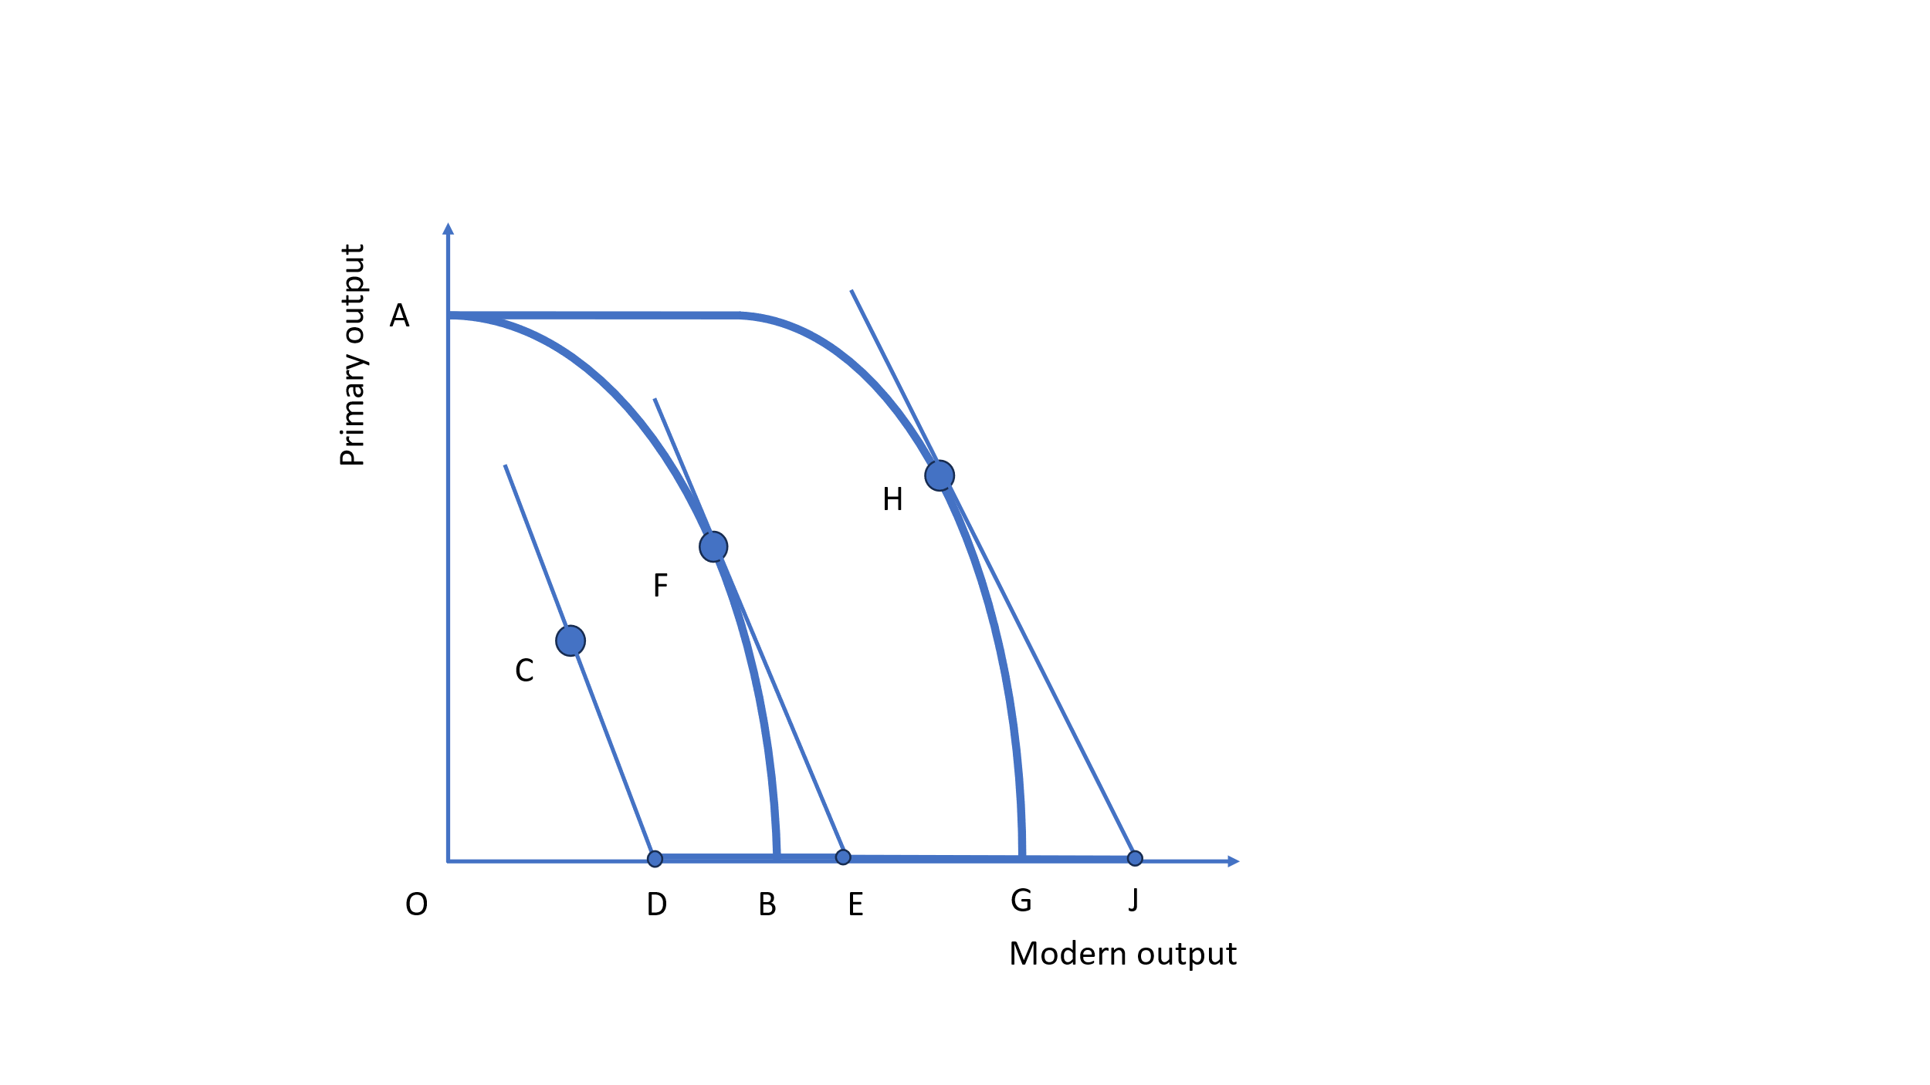
Background: Diversification and growth
Diversification shifts production frontier outward
From unemployment to full efficiency through diversification
C : Underutilized resources, with booms and busts, need stabilization
From C to F : Full employment of all resources, entailing choice between primary output and modern output
From F to H : Diversification, more efficiency, higher GDP per person
Shaped like a sickle
Primary output
H
F
C
Stagnation
Modern output

Slide 6
Export diversification, concentration, and growth
Finger-Kreinin index of diversification
and per capita GNI 1995-2018
(USD, ppp, 2018 prices, 181 countries)
Herfindahl-Hirschman index of concentration
and per capita GNI 1995-2018
(USD, ppp, 2018 prices, 181 countries)
Mongolia
Shaped like a sickle
Rapid growth
Stagnation
Stagnation
Sources: Authors' computations, based on UNCTAD and World Bank, World Development Indicators.

Slide 7
Export diversification, export quality, and growth
Theil index of diversification 1990-2014
and per capita GNI 1995-2018
(USD, ppp, 2018 prices, 174 countries)
IMF index of product quality 1990-2014
and per capita GNI 1995-2018
(USD, ppp, 2018 prices, 159 countries)
Shaped like a sickle
Rapid growth
Stagnation
Stagnation
Sources: Authors' computations, based on IMF and World Bank, World Development Indicators.

Slide 8
Economic complexity and growth
Economic complexity (SITC)
and per capita GNI 1995-2018
(USD, ppp, 2018 prices, 174 countries)
Economic complexity (HS)
and per capita GNI 1995-2018
(USD, ppp, 2018 prices, 159 countries)
Shaped like a sickle
Rapid growth
Clear cross-country pattern:
Diversification and growth go together
Stagnation
Stagnation
Sources: Authors' computations, based on Atlas of Economic Complexity and World Bank, World Development Indicators.

Slide 9
Diversification of assets and production
Asset diversification can facilitate
product diversification
Asset and product diversification
Diversifies portfolio of national assets (inputs): natural and produced capital and intangible assets (human capital and institutions)
Changes comparative advantage and hedges structural risks
Increases flexibility, resilience and productivity across economy
Asset diversification
(Share of non-natural capital in total wealth)
Shaped like a sickle
Rapid growth
Product diversification
(Finger-Kreinin index)
Diversifies outputs and exports away from mining through energy-intensive industrialisation
Builds on current comparative advantage and hedges cyclical risks
Increases exposure to low-carbon transition
Stagnation
Stagnation
Source: World Bank, 2020.

Slide 10
Selected determinants of economic growth
GNI per person, life expectancy, and human development
  Three sides a triangle (or a thick coin)
Education
  Leave out investment and trade (except trade diversification)
Economic organization and industrial structure
  Human vs. natural capital
Democracy and governance
  Social capital: Equality, transparencey, trust, etc.
  Let us walk you through the charts

Slide 11
Growth of per capita GDP
(% per year), 1990-2018
Structural peers
(countries similar to Mongolia)
Aspirational peers
(countries Mongolia aspires to resemble)
Mongolia:
Middle of the road
Shaped like a sickle
Rapid growth
Stagnation
Stagnation
Source: World Bank, World Development Indicators.

Slide 12
Life expectancy at birth
(years), 1990-2018
Structural peers
Aspirational peers
Shaped like a sickle
Rapid growth
Stagnation
Stagnation
Mongolia:
Lags behind
Source: World Bank, World Development Indicators.

Slide 13
Human Development Index, 2018
Structural peers
Aspirational peers
Shaped like a sickle
Rapid growth
Stagnation
Stagnation
Source: United Nations Development Programme.

Slide 14
Test scores, diversification, and growth,
1995-2018
Diversification and test scores
in 151 countries
Test scores and per capita GNI
in 150 countries
Shaped like a sickle
Rapid growth
Stagnation
Stagnation
Sources: World Bank, World Development Indicators and Human Capital Index, and United Nations Development Programme.

Slide 15
Educational attainment
(years at school), 1990-2010
Structural peers
Aspirational peers
Shaped like a sickle
Rapid growth
Stagnation
Stagnation
Sources: Barro and Lee (2013), ‘A New Data Set of Educational Attainment in the World, 1950 2010’, Journal of Development Economics.

Slide 16
Secondary school enrolment
(% of school-age cohort), 1990-2017
Structural peers
Aspirational peers
Mongolia:
Rapid progress
Shaped like a sickle
Rapid growth
Stagnation
Stagnation
Sources: World Bank, World Development Indicators.

Slide 17
Fertility rate
(births per woman), 1990-2018
Structural peers
Aspirational peers
Mongolia:
Child Money Programme
Shaped like a sickle
Rapid growth
Stagnation
Stagnation
Sources: World Bank, World Development Indicators.

Slide 18
Natural capital and human capital
(% of total wealth), 2014
Structural peers
Aspirational peers
Mongolia: Needs more human capital
Shaped like a sickle
Rapid growth
Stagnation
Stagnation
Sources: World Bank, The Human Capital Project.

Slide 19
Human capital index, 2017
Structural peers
Aspirational peers
Shaped like a sickle
Rapid growth
Stagnation
Stagnation
Sources: World Bank, The Human Capital Project.

Slide 20
Total natural resource rents
(% of GDP), 1990-2017
Structural peers
Aspirational peers
Shaped like a sickle
Rapid growth
Stagnation
Stagnation
Sources: World Bank, World Development Indicators.

Slide 21
Corruption perceptions index, 2000-2019
Social indicators
Structural peers
Aspirational peers
Shaped like a sickle
Rapid growth
Mongolia:
Mixed results
Stagnation
Stagnation
Source: Transparency International.

Slide 22
Trust index, 2017-2020
Structural peers
Aspirational peers
Mongolia:
Middle of the road
Shaped like a sickle
Rapid growth
Stagnation
Stagnation
Source: World Values Survey.

Slide 23
Rule of law
(average index from 0 to 1), 2012-2020
Structural peers
Aspirational peers
Mongolia:
Mixed results
Shaped like a sickle
Rapid growth
Stagnation
Stagnation
Source: World Justice Project.

Slide 24
Gini index of inequality, 1990-2016
Structural peers
Aspirational peers
Shaped like a sickle
Rapid growth
Mongolia:
Middle of the road
Stagnation
Stagnation
Sources: World Bank, World Development Indicators.

Slide 25
Finger-Kreinin index of export diversification, 1995-2018
Structural peers
Aspirational peers
Shaped like a sickle
Rapid growth
Mongolia:
Need to diversify
Stagnation
Stagnation
Source: UNCTAD.

Slide 26
Herfindahl-Hirschman index of export concentration, 1995-2018
Structural peers
Aspirational peers
Mongolia:
Need to diversify
Shaped like a sickle
Rapid growth
Stagnation
Stagnation
Source: UNCTAD.

Slide 27
Theil index of export diversification, 1990-2014
Structural peers
Aspirational peers
Mongolia:
Need to diversify
Shaped like a sickle
Rapid growth
Stagnation
Stagnation
Source: IMF.

Slide 28
IMF index of product quality
(average), 1990-2014
Structural peers
Aspirational peers
Mongolia: Well done
Shaped like a sickle
Rapid growth
Stagnation
Stagnation
Source: IMF.

Slide 29
Economic complexity
(average index from -1 to +1), 1995-2017
Structural peers
Aspirational peers
Mongolia: Need for
more complexity
Shaped like a sickle
Rapid growth
Stagnation
Stagnation
Source: Atlas of Economic Complexity.

Slide 30
Interest rate spread
(lending rate minus deposit rate in %), 1990-2018
Structural peers
Aspirational peers
Shaped like a sickle
Mongolia: Need for
more efficient banking
Rapid growth
Stagnation
Stagnation
Source: World Bank, World Development Indicators.

Slide 31
Democracy
(index from -10 to +10), 1990-2018
Structural peers
Aspirational peers
Shaped like a sickle
Rapid growth
Mongolia: Well done!
Stagnation
Stagnation
Source: Polity IV Project.

Slide 32
Global freedom status
(index from 0 to 100), 2019
Structural peers
Aspirational peers
Mongolia: Well done!
Shaped like a sickle
Rapid growth
Stagnation
Stagnation
Source: Freedom House.

Slide 33
Liberal democracy
(index from 0 to 1), 2022
Structural peers
Aspirational peers
Mongolia:
Middle of the road
Shaped like a sickle
Rapid growth
Stagnation
Stagnation
Source: V-Dem Institute.

Slide 34
Highlights I
Benign entanglement
  Good things tend to go together
Human vs. natural capital
  Mongolia is middle-of-the-road despite its relatively large stock of natural capital, with human capital on par with several peers
  Mongolia's resource rents are the largest among its peers
Realignment of fiscal policy
  Resource depletion fees can be used to generate revenue to reduce less efficient taxation or to mobilise outlays on education, health care, etc.
  Revenue from fees can be used to build up a sovereign wealth fund
    Think Alaska, Norway, and more

Slide 35
Highlights II
Need for diversification to strengthen social capital
  Corruption has declined and resembles structural peers
  In terms of trust, Mongolia is broadly comparable with structural peers
  The rule of law in Mongolia surpasses its structural peers, but lags all of its aspirational peers
  Income distribution is not an issue for Mongolia
  Mongolian exports are less diversified than among most of its peers, but comparatively high-quality in terms of trading partners.
  The lack of foreign competition – i.e., lack of diversity – in Mongolian banking accords with general pattern of insufficient diversity

Slide 36
Highlights III
Mongolia has excelled in terms of political diversification
  By establishing a solid liberal democratic reputation in a challenging geographical neighbourhood
The strong state of Mongolian democracy should make it easier to pursue benign entanglement with popular support by
  Strengthening education and health care
  Reinforcing the rule of law
  Reducing corruption
  Reallocating resources along the lines of desirable economic diversification …
    As, e.g., Alaska (pop. 734,000), has managed to do
The End

