Slide 1
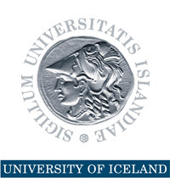
Natural Resources, Energy Prices, and Diversification
International Conference on Energy Prices: Macroeconomic and Financial Impacts University of Paris Ouest Nanterre-La Défense, 4-5 June 2015
Thorvaldur Gylfason

Slide 2
Price of Oil
Before its recent drop by a half, it had risen by a factor of ten in real terms since 1970
Compared with 68% increase in prices of metals and minerals
Price hikes of 1973-74 and 1979-81 changed the world – Toyota up, GM down, etc.
Decrease by 50% since 2014 made RUB collapse, while NOK lost 1/6 of its value
Russia is less diversified than Norway

Slide 3
Price of Oil
Value of oil rose from 1% of world GDP in 1973 to 5% in 2013
Meanwhile, world oil intensity decreased by a half as global production became more energy efficient
Further, abundant oil is blamed for lack of diversification in many countries
Economic diversification
Political diversification

Slide 4
Double Diversification
Mauritius
Economic diversification
Spurs growth by attracting economic activity from excessive reliance on natural-resource-based industries toward a broad economic base
Political diversification
Spurs growth by redistributing political power from narrowly based ruling elites to the people, often replacing an extended monopoly of sometimes ill-gotten power by democracy
Two sides of same coin: Diversity pays

Slide 5
Double Diversity is Good for Growth
Economic diversity as measured by
Share of manufactures in total exports
Herfindahl index of export diversification
Political diversity as measured by
Polity2 index of democracy (from -10 to +10)
Freedom House index of democracy (from 7 to 1)
Economic and political diversity go together
Failure to diversify economy tends to stifle political diversification and vice versa

Slide 6
Evidence: From Economic and Political Diversification to Growth
From Diversification to Growth
Note: Each dot represents a country
From Democracy to Growth
Log of GNI per capita 2012 (USD, ppp)
Manufactures exports 1962-2012 (% of total)
Democracy 1960-2012 (from -10 to 10)

Slide 7
Evidence: From Economic and Political Diversification to Growth
From Diversification to Growth
Note: Each dot represents a country
From Democracy to Growth
Log of GNI per capita 2012 (USD, ppp)
Export diversification index 1996-2012
Democracy 1972-2014 (from 7 to 1)

Slide 8
Side by Side: Different Aspects of Economic and Political Diversification
Export Diversification: Two Types
Note: Each dot represents a country
Democracy: Two Measures
Manufactures exports 1962-2012 (% of total)
Democracy (Polity2) 1960-2012
Export diversification index 1996-2012
Democracy (Freedom House) 1972-2014

Slide 9
From Export Diversification to Growth
Natural Capital and Diversification
Export Diversification and Income

Slide 10
From Democracy to Growth
Natural Capital and Democracy
Democracy and Income

Slide 11
Progress of Democracy
Europe
1943: Five democracies
Now: Full house
Africa
1960-1990: Five or less democracies
Now: 17 democracies
South America (Spanish or Portuguese)
1961: Three democracies out of ten
Now: Eight out of ten

Slide 12
Progress of Diversification
Manufactures exports (% of total)
Source: World Bank, World Development Indicators.

Slide 13
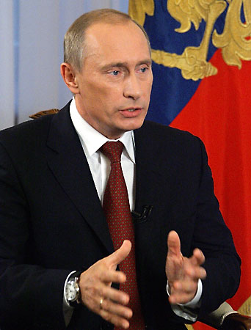
The Dangers of Failure to Diversify Are Real
Rent seeking often results in conflict, corruption, economic stagnation, oppression, lack of democracy
Dutch disease through overvalued and volatile currencies tends to stifle exports like undervalued currencies simulate exports (e.g., China)
False sense of security breeds neglect of human resources and social capital via education and institution building, including governance and democracy
“Our country is rich, but our people are poor.”

Slide 14
Natural Resources May Undermine Finance
Abundant natural resources may hamper the functioning of the financial system
Dissaving takes place through more rapid resource depletion
Saving takes place through less rapid depletion or more rapid renewal or deposits abroad
Result is weaker links between domestic savers and investors, distorting allocation of capital
Lack of financial depth hurts efficiency and growth

Slide 15
Law and Economics: Natural Resources and Human Rights
Natural resources belong to the people …
A people’s right to their natural resources is a human right proclaimed in international law and enshrined in many national constitutions
… but they may challenge democracy
Low taxes and generous transfers and subsidies, even if they amount to only a small fraction of each citizen’s fair share of the nation’s oil wealth, tend to weaken popular demand for democracy

Slide 16
Democracy and Good Governance
Norway was a fully fledged democracy long before its oil discoveries
Oil wealth has never been a source of conflict between haves and have-nots
Unlike Russia and Iceland, Norway has no oligarchs
Norway’s Ten oil commandments lay down ethical guidelines for oil wealth management
Good governance can be an effective remedy against rent seeking

Slide 17
Norway´s Sovereign Wealth Fund
From day one, Norway’s oil and gas reserves were defined by law as common property resources, clearly establishing the legal rights of the Norwegian people to the resource rents
On this legal basis, government has absorbed about 80% of the resource rent over the years
Oil Fund (Pension Fund): USD 900 billion
Managed by independent Central Bank
Norway resisted temptation to use too much of its oil wealth to meet current needs
USD 180K per person

Slide 18
Norway’s Ten Oil Commandments
#1 National supervision and control must be ensured for all operations on Norway’s Continental Shelf
#2 Petroleum discoveries must be exploited in a way which makes Norway as independent as possible of others for its supplies of crude oil
#3 New industry will be developed on the basis of petroleum

Slide 19
Norway’s Ten Oil Commandments
#4 The development of an oil industry must take necessary account of existing industrial activities and the protection of nature and the environment
#7 The state must become involved at all appropriate levels and contribute to a coordination of Norwegian interests in Norway’s petroleum industry as well as the creation of an integrated oil community which sets its sights both nationally and internationally

Slide 20
Norway’s Ten Oil Commandments
#8 A state oil company will be established which can look after the government’s commercial interests and pursue appropriate collaboration with domestic and foreign oil interests
#10 Large Norwegian petroleum discoveries could present new tasks for Norway’s foreign policy

Slide 21
Conclusion: Step by Step
Developing countries with pressing economic and social needs cannot be expected to show the same patience as Norway
No one-size-fits-all blueprint is available to guide resource-rich countries to a sustainable path of successful economic diversification
Seek path of least resistance, doing easy things first, climbing the ladder rim by rim
Education and infrastructure, including institutions
Trade and investment, domestic and foreign

