Slide 1
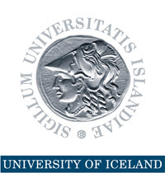
Natural Resources: Nordic Lessons
6th annual Gaidar Forum Russia and the World: New Dimensions Russian Presidential Academy of National Economy and Public Administration Moscow 14-16 January 2015
Thorvaldur Gylfason

Slide 2
Natural Resources in Nordic Countries
Finland, Iceland, Norway, and Sweden have all benefited from their natural resources
Finland and Sweden outgrew their dependence on natural resources
Norway has managed its oil exceptionally well
Yet, what made the Nordics rich was not so much their natural resources as their use of human capital to harness their natural wealth
Need to diversify by converting natural resources into human resources and social capital

Slide 3
Nordic Countries Benefited from Double Diversity
Economic diversification (acquired)
Spurs growth by attracting economic activity from excessive reliance on primary production in agriculture or natural-resource-based industries
Political diversification (inherited from past)
Spurs growth by redistributing political power from narrowly based ruling elites to the people, often replacing an extended monopoly of power by democracy, encouraging widely shared education
Two sides of same coin: Diversity pays

Slide 4
Evidence: From Economic and Political Diversification to Growth
From Diversification to Growth
Note: Each dot represents a country
From Democracy to Growth
Log of GNI per capita 2012 (USD, ppp)
Manufactures exports 1962-2012 (% of total)
Democracy 1960-2012 (from -10 to 10)

Slide 5
Progress of Democracy
Europe
1943: Five democracies
Now: Full house
Africa
1960-1990: Five or less democracies
Now: 17 democracies
South America (Spanish or Portuguese)
1961: Three democracies out of ten
Now: Eight out of ten

Slide 6
Progress of Diversification
Manufactures exports (% of total)
Source: World Bank, World Development Indicators.

Slide 7
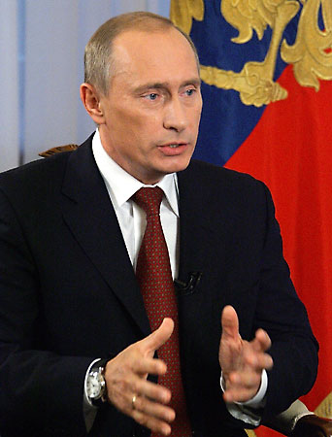
The Risks Are Real
Rent seeking often results in conflict, corruption, economic stagnation, oppression, lack of democracy
Dutch disease through overvalued and volatile currencies tends to stifle exports like undervalued currencies simulate exports (e.g., China)
False sense of security breeds neglect of human resources and social capital via education and institution building, including governance and democracy
“Our country is rich, but our people are poor.”

Slide 8
Natural Resources and Human Rights
Natural resources belong to the people …
A people’s right to their natural resources is a human right proclaimed in international law and enshrined in many national constitutions
… but they may challenge democracy
Low taxes and generous transfers and subsidies, even if they amount to only a small fraction of each citizen’s fair share of the nation’s oil wealth, tend to weaken popular demand for democracy

Slide 9
Democracy and Good Governance
Norway was a fully fledged democracy long before its oil discoveries
Oil wealth has never been a source of conflict between haves and have-nots
Norway has no oligarchs
Norway’s Ten oil commandments lay down ethical guidelines for oil wealth management
Good governance can be an effective remedy against rent seeking

Slide 10
Sovereign Wealth Fund
From day one, Norway’s oil and gas reserves were defined by law as common property resources, clearly establishing the legal rights of the Norwegian people to the resource rents
On this legal basis, government has absorbed about 80% of the resource rent over the years
Oil Fund (Pension Fund): USD 850 billion
Managed by independent Central Bank
Norway resisted temptation to use too much of its oil wealth to meet current needs

Slide 11
Step by Step
No one-size-fits-all blueprint is available to guide resource-rich countries to a sustainable path of successful economic diversification from natural to human and social capital
No blueprint exists for sequencing of actions
Better, perhaps, to seek path of least resistance and climb the ladder rim by rim by boosting
Trade and investment, domestic and foreign
Education and infrastructure, including institutions
The end

