Slide 1
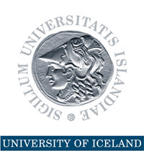
Inequality Undermines Democracy and Growth
World Bank 26 September 2019
Thorvaldur Gylfason

Slide 2
Background
Inequality of income and wealth has suddenly entered the mainstream of economic and political discourse
Inequality among nations has decreased since 1980, with the ascent of China and India, while inequality within nations has increased
Increased inequality has transformed politics …
Exhibit A: Sen. Sanders became a mainstream politician
Exhibit B: Trump won presidency by appealing to those left behind
Exhibit C: UK voters chose Brexit on similar grounds
Democracy is under stress in Europe and US
… and merits closer macroeconomic scrutiny

Slide 3
Outline
Main aim here is to chart cross-country relationships among income distribution, economic growth or, rather, per capita GNI, and several possible determinants of growth
Full-fledged econometric analysis must wait
Growth is driven by buildup and use of four kinds of capital
Physical capital – Accumulation
Human capital
Natural capital
Social capital
Here we stress social capital, or five aspects thereof:
Democracy, equality, rule of law, transparency, and trust
Efficiency, incl. technology

Slide 4
From social capital to growth
Red arrows denote new results on inequality
Blue arrows denote earlier results on diversification
Green arrows denote new results on trust
Economic diversification
Economic growth
Political diversification
Trust
Transparency
Rule of law
Equality
Yellow arrows denote earlier results on rule of law and transparency

Slide 5
Proceed in three steps
Does economic diversification – i.e., the distribution of GNI across industries – matter for the level of GNI?
If diversification boosts output, that may help to explain why natural resource dependence, if not well managed, may stunt output
Does political diversification – i.e., fortified democracy – matter for economic diversification and the level of GNI?
Economic and political diversification can be viewed as parallel ways of averting excessive concentration and associated risk
Do different aspects of social capital – equality, rule of law, transparency, trust – matter for diversification and GNI?

Slide 6
Double diversification
1
Policy2 index of democracy 1960-2012 and Theil index of export diversification 1962-2010 (148 countries)
Two sides of the same coin
Economic diversification means diversification of exports and output away from excessive dependence on natural resources
Political diversification means increased democracy, i.e., diversification away from excessive dependence on a narrow political base toward political pluralism
Both aim to avert national risk
Can adjust Theil index for country size
8 minus Theil index 1962-2012
Note: Vertical axis shows 8 minus Theil index so diversification increases upward along vertical axis

Slide 7
From diversification to growth
1
Most countries, especially those that rely on a few industries or resources for much of their incomes, seek to diversify their economies
They view diversification as an essential aspect of national risk management
Some may suspect that, by reducing risk, diversification may also encourage economic efficiency and growth
What do the data say?
Let‘s look at some simple correlations in preparation for more comprehensive econometric work yet to be undertaken

Slide 8
From double diversification to per capita income
“20/50 rule”
Theil index of export diversification 1962-2010 and log per capita GNI 2016 (167 countries)
Policy2 index of democracy 1960-2012 and log per capita GNI 2016 (154 countries)
Log GNI per person 2016 (USD, ppp)
Log GNI per person 2016 (USD, ppp)
Source: Author´s computations
Note: Horizontal axis in left panel shows 8 minus Theil index so diversification increases from left to right; horizontal axis in right panel shows Polity2 index of democracy

Slide 9
20/50 rule
An increase in economic diversification by 20% of the scale of the diversification index along horizontal goes along with a 50% increase in per capita GNI along vertical axis
An increase in political diversification (democracy) by 20% of the scale of the democracy index along horizontal axis goes along with a 50% increase in per capita GNI along vertical axis

Slide 10
Clear impression from data
Economic diversification is positively correlated with per capita GNI across countries
All available measures of diversification give same result
Perhaps an index of economic diversification belongs in cross-country growth regressions as a more broadly-based replacement for indicators of natural resource intensity currently in use
Work in progress

Slide 11
Social capital: Transparency
2
Lack of transparency can undermine democracy and growth
“Publicity is justly commended as a remedy for social and industrial diseases. Sunlight is said to be the best of disinfectants; electric light the most efficient policeman.”
Louis Brandeis, US Supreme Court Justice 1916-1939
No independent statistical measure of transparency exists yet
So, given that Corruption Perceptions Index varies inversely with corruption by construction, we define transparency as
Transparency = Corruption Perceptions Index
Source: Transparency International

Slide 12
From transparency to double diversification
Transparency index of 2012-2016 and Theil index of export diversification 1962-2010 (159 countries)
Transparency index 2012-2016 and polity2 index of democracy 1960-2012 (158 countries)
8 minus Theil index 1962-2012
Polity2 index 1960-2012
Source: Author´s computations
Note: Horizontal axes show Transparency index

Slide 13
Social capital: Rule of law
3
Weak rule of law can undermine democracy and growth
“… human rights, the rule of law and democracy are interlinked and mutually reinforcing and … they belong to the universal and indivisible core values and principles of the United Nations”
Declaration adopted on 24 September 2012 by UN General Assembly
New measure of rule of law from the World Justice Project is based on expert opinion as well as public opinion
Composite index, reflecting various aspects of the rule of law
Constraints on Government Powers, Absence of Corruption, Open Government, Fundamental Rights, Order and Security, Regulatory Enforcement, Civil Justice, and Criminal Justice
Coverage: 2012 to date

Slide 14
From rule of law to double diversification
Rule of law index 2012-2018 and Theil index of export diversification 1962-2010 (110 countries)
Rule of law index 2012-2018 and polity2 index of democracy 1960-2012 (151 countries)
8 minus Theil index 1962-2012
Polity2 index 1960-2012
Source: Author´s computations
Note: Horizontal axes show Rule of law index

Slide 15
Social capital: Trust
4
Trust is another important ingredient of social capital
Emerging signs of declining trust
Robert Putnam´s Bowling Alone (2000)
Gallup reports that public confidence has been eroded
Trust in US Congress decreased from 42% in 1972 to 12% in 2017
Trust in US presidency decreased from 52% in 1975 to 32% in 2017
Trust in OECD banks decreased from 55% in 2007 to 46% in 2015
World Values Survey has gauged trust in six waves 1981-2014
“Most people can be trusted” vs. “Need to be very careful”

Slide 16
From trust to double diversification
Trust index 1981-2014 and Theil index of export diversification 1962-2010 (100 countries)
Trust index 1981-2014 and Polity2 index of democracy 1960-2012 (98 countries)
8 minus Theil index 1962-2012
Polity2 index 1960-2012
Source: Author´s computations
Note: Horizontal axes show Trust index

Slide 17
From trust to equality and per capita income
Trust index 1981-2014 and Gini index of inequality 1979-2016 (95 countries)
Trust index 1981-2014 and log per capita GNI 2016 (102 countries)
100 minus Gini index 1979-2016
Log GNI per person 2016 (USD, ppp)
Source: Author´s computations
Note: Horizontal axes show Trust index; in left panel, equality rises upward along vertical axis

Slide 18
Social capital: Inequality
5
Inequality can undermine democracy and growth
“We can have democracy in this country, or we can have great wealth concentrated in the hands of a few, but we can't have both.”
Louis Brandeis, US Supreme Court Justice 1916-1939
The top 1% of households saw its share in total pre-tax income rise from 8% in 1980 to 12% in Europe and 20% in US in 2015 as in Russia
The top 1% of households saw its share of total net wealth rise from 20% in 1980-1990 to 40% in 2015 as in Russia
Source: World Inequality Database
Gini indices are averages taken from World Development Report
Coverage: 1979-2016 at most, usually much shorter periods

Slide 19
Income inequality: Two measures
Two sets of data on inequality
Standardized Gini index 1962-2017 and Gini index 1979-2016 (180 countries)
World Development Indicators (WDI)
Available for 1979-2016 but only a few scattered data points for each country
Standardized World Income Inequality Database (SWIID)
More countries and years, 1962-2017, fewer gaps
The two sets are closely correlated
Here, use WDI
Can reproduce all results by using SWIID instead

Slide 20
Social capital: Two sides of the story
From inequality to growth – two aspects
Just as we assess stocks of assets in two dimensions, i.e., in terms of return and risk, we may need to assess flows of income and expenditure the same way, i.e., in terms of averages and spreads (means and standard deviations)
Knowing GNI or life expectancy is not enough if we do not also know their distribution across population
First approach: GNI vs. GNI ^{adj} = GNI * (1 - Gini) – see next slide
Inequality – like transparency, corruption, democracy, and rule of law – belongs in economic analysis if it interacts with GNI, its rate of growth, and its determinants
Here we review such linkages in a cross-country-setting

Slide 21
GNI per hour worked 2014, with and without adjustment for inequality (2015 USD, ppp)
y^{adj} = y*(1 - Gini)
Source: Author’s computations based on The Conference Board Total Economy Database™, May 2016.

Slide 22
From equality to double diversification
Gini index 1979-2016 and Theil index of export diversification 1962-2010 (146 countries)
Gini index 1979-2016 and polity2 index of democracy 1960-2012 (146 countries)
8 minus Theil index 1962-2012
Polity2 index 1960-2012
Source: Author´s computations
Note: Horizontal axes show 100 minus Gini index so equality rises from left to right in both panels

Slide 23
From equality to transparency and rule of law
Gini index 1979-2016 and transparency index 2012-2016 (155 countries)
Gini index 1979-2016 and rule of law index 2012-2018 (100 countries)
Transparency index
Rule of law index
Source: Author´s computations
Note: Horizontal axes show 100 minus Gini index so equality rises from left to right in both panels

Slide 24
Social capital: Democracy
6
Democracy can be viewed as important pillar of social capital
“We can have democracy in this country, or we can have great wealth concentrated in the hands of a few, but we can't have both.”
Louis Brandeis, US Supreme Court Justice 1916-1939
Democracy is related to other aspects of social capital across countries
Equality
Rule of law
Transparency – i.e., absence of corruption
Trust
Democracy has been under stress since 2006

Slide 25
Democracy has lost ground
Source: Freedom House

Slide 26
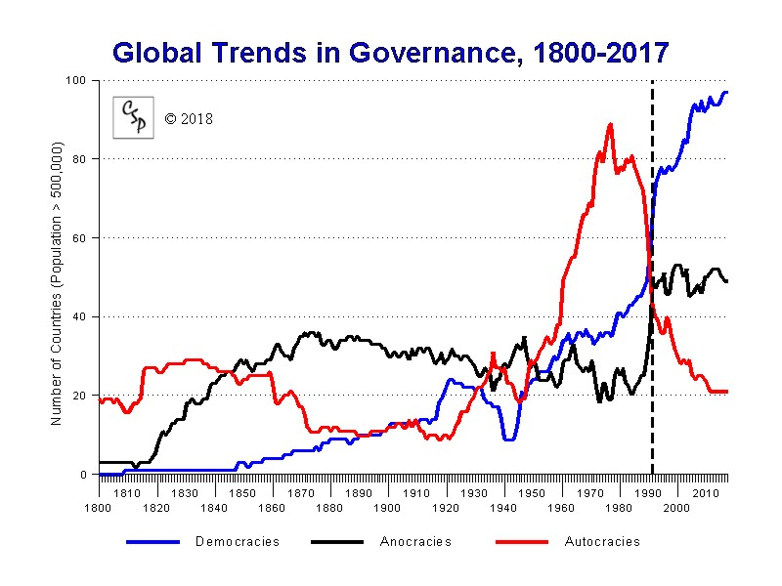
Democracy 1800-2017
Democracy
Anocracy
Autocracy

Slide 27
Democracy in Africa
Democracy in sub-Saharan Africa 1960-2016 (47 countries)
Average democracy score in sub-Saharan Africa 1956-2017 (47 countries)
Source: Author´s computations based on Polity IV data.

Slide 28
From equality to democracy and growth
Gini index 1979-2016 and polity2 index 1960-2012 (146 countries), again
Gini index 1979-2016 and log per capita GNI 2016 (161 countries)
Again
Polity2 index 1960-2012
Log GNI per person 2016 (USD, ppp)
Source: Author´s computations
Note: Horizontal axes show 100 minus Gini index so equality rises from left to right in both panels

Slide 29
Lessons for Europe and United States
7
Economic diversity shows no signs of weakening
Democracy does, however, show signs of stress
Since 2008, Freedom House has gradually downgraded US to 86 compared with 99/100 for Canada
Supreme Court verdict in 2010 effectively abolished limits on corporate contributions to politicians
Burgeoning political science literature now describes US as an oligarchy that systematically disrespects the will of the people
Many Europeans and others also worry about recent political developments in Hungary and Poland (“illiberal democracy”)
Grim lesson from early 20th century
Increased inequality has undermined democracy before (Snyder, 2018)

Slide 30
Web of linkages
Red arrows denote new results on inequality
Blue arrows denote earlier results on diversification
Green arrows denote new results on trust
Economic diversification
Economic growth
Political diversification
Trust
Transparency
Rule of law
Equality
Yellow arrows denote earlier results on rule of law and transparency

Slide 31
Conclusion: Reasonable equality, like trust, is good for democracy and growth
8
Equality and trust go along with several other key determinants of economic growth and with per capita GNI across countries
Equality in distribution of income goes along with
Economic diversification
Rule of law
Transparency
Trust
Democracy
All six are good for growth, as are saving, investment, education, and health care while natural resources can cut both ways
Need also to study equality in distribution of wealth and health
Fini

