Slide 1
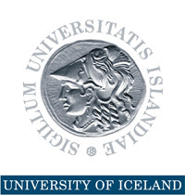
Economic Diversification and Industrialization in Countries Rich in Natural Resources
15th session of the UNIDO General Conference on Towards partnerships for a new industrial revolution for inclusive and sustainable growth, Lima, Peru, 2-6 December 2013
Thorvaldur Gylfason

Slide 2
Natural Resources in Nordic Countries
Finland, Iceland, Norway, and Sweden have all benefited from their natural resources
Finland and Sweden outgrew their dependence on natural resources
Norway has managed its oil exceptionally well
Yet, what made the Nordics rich was not so much their natural resources as their use of human capital to harness their natural wealth
Need to diversify by converting natural capital into human capital and social capital

Slide 3
Double Diversification
Economic diversification
Spurs growth by attracting economic activity from excessive reliance on primary production in agriculture or natural-resource-based industries
Political diversification
Spurs growth by redistributing political power from narrowly based ruling elites to the people, often replacing an extended monopoly of sometimes ill-gotten power by democracy
Two sides of same coin: Diversity pays

Slide 4
Evidence: From Economic and Political Diversification to Growth
From Diversification to Growth
Note: Each dot represents a country
From Democracy to Growth
Log of GNI per capita 2012 (USD, ppp)
Manufactures exports 1962-2012 (% of total)
Democracy 1960-2012 (from -10 to 10)

Slide 5
Progress of Democracy
Europe
1943: Five democracies
Now: Full house
Africa
1960-1990: Five or less democracies
Now: 17 democracies
South America (Spanish or Portuguese)
1961: Three democracies out of ten
Now: Eight out of ten, including Peru

Slide 6
Progress of Diversification
Manufactures exports (% of total)

Slide 7
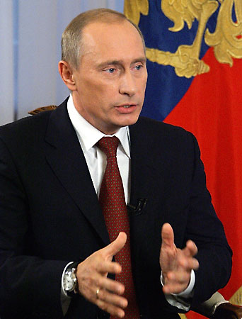
The Risks Are Real
Rent seeking often results in conflict, corruption, economic stagnation, lack of democracy
Dutch disease through overvalued and volatile currencies tends to stifle exports like undervalued currencies simulate exports (e.g., China)
False sense of security breeds neglect of human and social capital through education and institution building, including democracy
“Our country is rich, but our people are poor.”

Slide 8
The Success Stories Are Real, Too
Abundant natural wealth tends sometimes to attract the wrong sort of people to politics
Could list many failures (e.g., Nigeria)
Yet, several countries have done well, e.g.,
Botswana (diamonds)
Malaysia (minerals, timber, gas)
Mauritius (sugar)
Norway (oil)

Slide 9
Natural Resources and Human Rights
Natural resources belong to the people
A people’s right to their natural resources is a human right proclaimed in international law and enshrined in many national constitutions
Low taxes and generous transfers and subsidies, even if they amount to only a small fraction of each citizen’s fair share of the nation’s oil wealth, tend to weaken popular demand for democracy

Slide 10
Democracy and Good Governance
Norway was a fully fledged democracy long before its oil discoveries
Democrats are less likely than dictators to try to grab resources to consolidate their political power
Norway’s oil ‘commandments’ lay down ethical guidelines for oil wealth management
Good governance can be an effective remedy against rent seeking

Slide 11
Sovereign Wealth Funds
From day one, Norway’s oil and gas reserves were defined by law as common property resources, clearly establishing the legal rights of the Norwegian people to the resource rents
On this legal basis, government has absorbed about 80% of the resource rent over the years
Oil Fund (Pension Fund): USD 800 billion
Managed by independent Central Bank
Norway resisted temptation to use too much of the money to meet current needs

Slide 12
Step by Step
Developing countries with pressing economic and social needs cannot be expected to show the same patience as Norway
No one-size-fits-all blueprint is available to guide resource-rich countries to a sustainable path of successful economic diversification
Seek path of least resistance, doing easy things first, climbing the ladder rim by rim
Boost education, infrastructure, and institution building, including good governance
The end

