Slide 1

The Dutch Disease in Reverse Iceland’s Natural Experiment
8th RCEA Macro-Money-Finance Workshop
Rimini, Italy, 18-19 May 2017
Thorvaldur Gylfason
Gylfi Zoega

Slide 2
Key points
Abundant natural resources brought Iceland a systemically overvalued currency, with adverse effects on manufacturing and services
During 2003-2008 another national treasure, the sovereign’s AAA rating, was used to attract foreign capital, elevating the real exchange rate even further
The financial collapse in 2008 left Iceland with a large foreign debt without the possibility of rollovers in foreign capital markets
The currency plunged, producing a bout of the Dutch disease in reverse as witnessed, in particular, by a massive expansion of tourism after the crash

Slide 3
Key points
Insofar as the trouble with abundant natural resources and reputation mining has to do with the appreciation of the currency, the depreciation resulting from a financial crash can be viewed as a case of the Dutch disease in reverse
Just as currency appreciation weakens the current account, a massive depreciation after a financial crash stifles imports and strengthens exports, paving the way toward economic recovery

Slide 4
Literature
Recent literature highlights several channels through which natural resource abundance, if not well managed, may retard economic growth
  Rent seeking
  Dutch disease
  Poor governance
  Political or ethnic conflict
  Corruption
  Autocracy
  Excessive borrowing
  Low levels of education

Slide 5
Literature
Our 1999 model showed how a large and volatile primary sector would adversely affect the output of tradable goods by increasing real wages and the real exchange rate, lowering the relative price of tradable goods and hampering investment
If learning-by-doing occurs mostly in the secondary export sector and not in the primary sector, we also showed that natural resource booms are likely to hamper growth by discouraging employment and investment

Slide 6
Parallels
Foreign aid inflows share important properties with natural resource discoveries
  Aid constitutes an unrequited transfer emerging like manna from heaven
  Aid inflows have about them an aura of ‘other people’s money’ which, like lottery winnings, as well as due to their transitory and often volatile nature, may seem easy to fritter away
  Just as foreign aid may be diverted from its intended beneficiaries, natural resource abundance tends to attract the wrong sort of people to politics by offering opportunities to divert rents from their right owners

Slide 7
Parallels
Inflows of foreign credit can exert a similar manna-from-heaven effect on its recipients as resource windfalls and foreign aid …
  … not least if the borrowing nation behaves as if there is no tomorrow and bankers revel in their role as rentiers
In some cases, resource windfalls, foreign aid and rapid capital inflows may invite plunder …
  … with royal families, clerics, generals, politicians and bankers sitting in the driver‘s seat

Slide 8
GNI per capita 1990-2015
(Current international dollars, ppp)
Background
Denmark and Iceland
Greece, Iceland, Ireland, Latvia
Rapid recovery accompanied by quick return to full employment amid labor unrest
Source: World Bank, World Development Indicators.

Slide 9
Exports of goods and services and manufactures
Exports 1960-2015
(% of GDP)
Manufactures exports 1962-2015
(% of total exports)
When the króna plunged, exports shot up …
Iceland’s export share in GDP was flat 1870-2008
Source: World Bank, World Development Indicators.

Slide 10
Imports and domestic credit
Import volume 2000-2015
(2000 = 100)
Domestic bank credit 1960-2015
(% of GDP)
… and imports collapsed
Source: World Bank, World Development Indicators.

Slide 11
Investment and adjusted net saving
Gross investment 1965-2015
(% of GDP)
Adjusted net saving 2005-2015
(% of GNI)
Intended to reflect “real” difference between production and consumption
Iceland: Collapse of
net investment
(% of GDP)
Source: World Bank World Development Indicators.

Slide 12
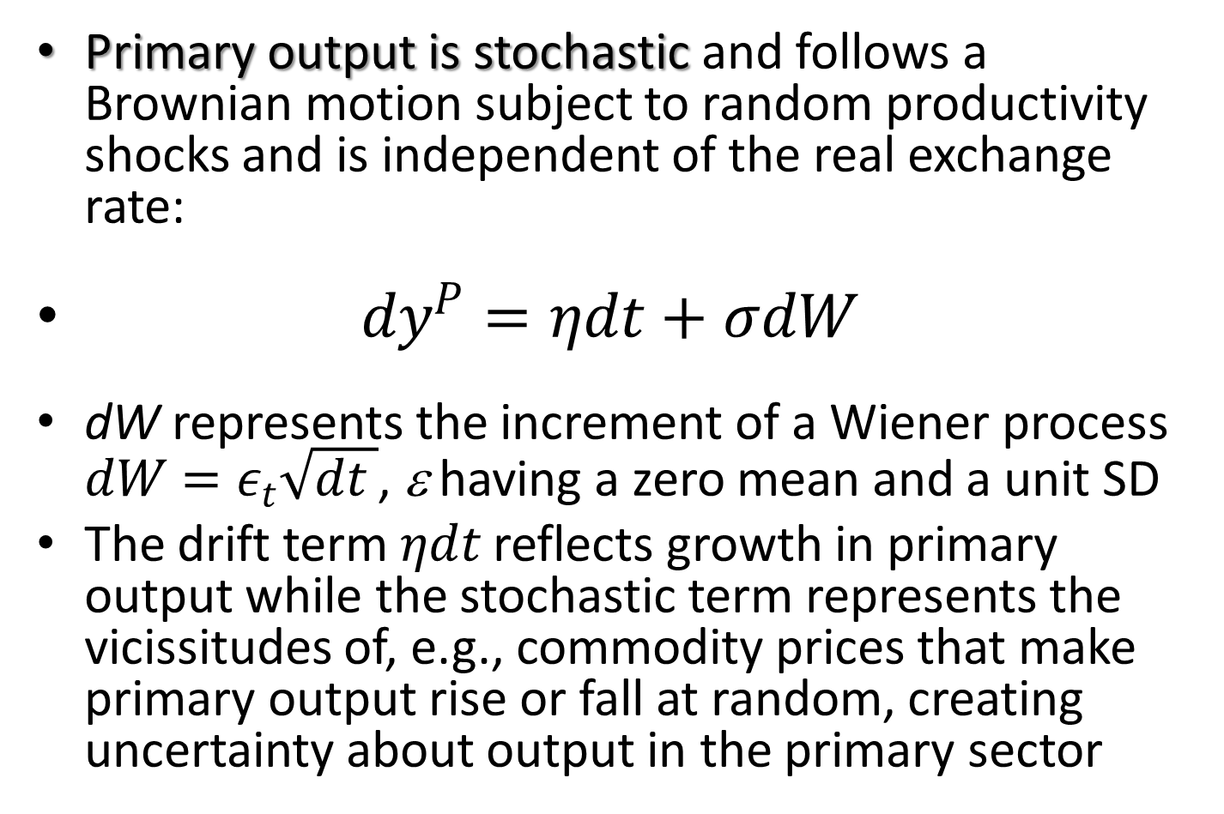
Model
Primary output is stochastic and follows a Brownian motion subject to random productivity shocks and is independent of the real exchange rate:
$dy^{P}=ηdt+σdW$
dW represents the increment of a Wiener process
$dW=ε_{t}\sqrt{dt }$, ε having a zero mean and a unit SD
The drift term $ηdt$ reflects growth in primary output while the stochastic term represents the vicissitudes of, e.g., commodity prices that make primary output rise or fall at random, creating uncertainty about output in the primary sector

Slide 13

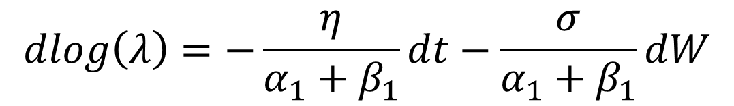
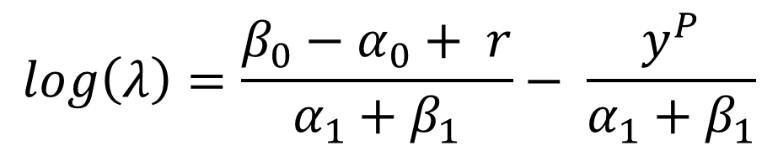

Model
Secondary output is deterministic
= real exchange rate
(appreciation makes λ fall)
r = saving that satisfies
intertemporal
budget constraint
$$y^{S}=α_{0}+α_{1}log\left(λ\right)$$
$$c^{T}=β_{0}−β_{1}log\left(λ\right)$$
$$log\left(λ\right)=\frac{{β_{0}−α}_{0}+ r}{α_{1}+β_{1}}− \frac{y^{P}}{α_{1}+β_{1}}$$
$$dlog\left(λ\right)=−\frac{η}{α_{1}+β_{1}}dt−\frac{σ}{α_{1}+β_{1}}dW$$

Slide 14
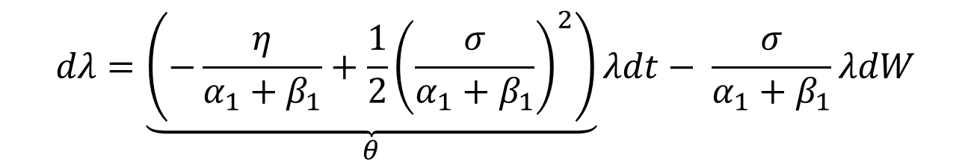
Model
Hence
$$dλ=\underset{θ}{\underbrace{\left(−\frac{η}{α_{1}+β_{1}}+\frac{1}{2}{\left(\frac{σ}{α_{1}+β_{1}}\right)}^{2}\right)}}λdt− \frac{σ}{α_{1}+β_{1}}λdW$$
The drift term, with θ < 0 denoting appreciation – a fall in the relative price of tradable goods – signals the Dutch disease
The volatility of the real exchange rate λ via the stochastic term may be no less important in its effect on investment for other export industries and import-competing industries
Derive and play with stochastic equation for Y^{s}:
dY^{S} = Adt + BdW

Slide 15
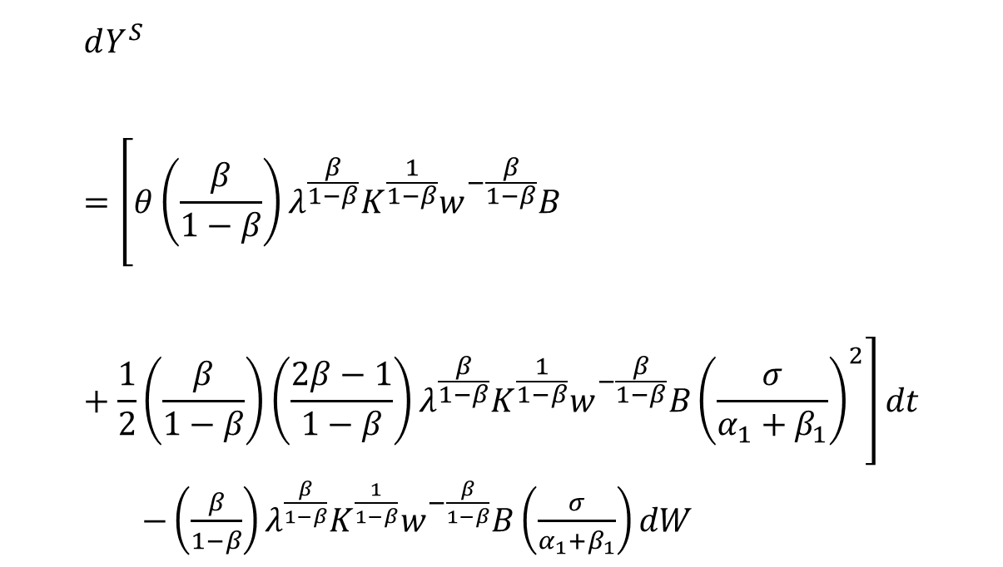
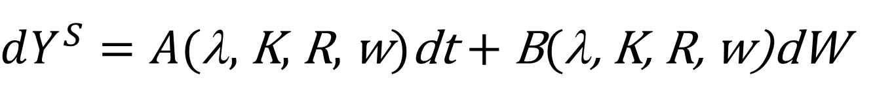
Model
Specifically
$$dY^{S}=\left[θ{\left(\frac{β}{1−β}\right)λ}^{\frac{β}{1−β}}K^{\frac{1}{1−β}}w^{−\frac{β}{1−β}}B+\frac{1}{2}\left(\frac{β}{1−β}\right)\left(\frac{2β−1}{1−β}\right)λ^{\frac{β}{1−β}}K^{\frac{1}{1−β}}{w^{−\frac{β}{1−β}}B\left(\frac{σ}{α_{1}+β_{1}}\right)}^{2}\right]dt$$
$−\left(\frac{β}{1−β}\right){λ^{\frac{β}{1−β}}K}^{\frac{1}{1−β}}w^{−\frac{β}{1−β}}B\left(\frac{σ}{α_{1}+β_{1}}\right)dW$
Hence
$dY^{S}=A(\text{λ}$, K, R, w)dt + B(λ, K, R, w)dW

Slide 16
Model
Primary output is stochastic, and so is, therefore, also the real exchange rate λ and secondary output
  Employment and output in secondary sector depend on λ, and hence on primary output and external debt as well as primary-sector wages
A primary-sector boom has an immediate adverse effect on secondary output by reducing λ (i.e., by making the currency appreciate), a key aspect of the Dutch disease

Slide 17
Upshot
Real exchange rate λ depends on current and lagged shocks to primary output and capital flows
Secondary output depends on λ
Consumption of tradable goods also depends on λ
So, through λ, primary output shocks and volatility, like capital flows, impact secondary output, employment and consumption

Slide 18
Data: Real exchange rate, current account, tourism and non-primary merchandise exports
Real exchange rate and the current account
Real exchange rate and tourism
Real exchange rate and change in tourism
Real exchange rate and other exports

Slide 19

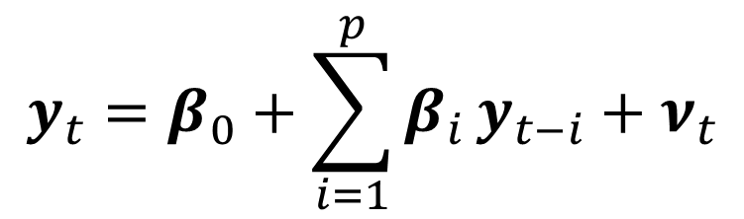
VAR model
$$y_{t}=β_{0}+\sum_{i=1}^{p}{β_{i}}y_{t−i}+ν_{t}$$
$$\left.y_{t}^{′}=(E,CA, ΔT, ΔNP\right)$$
E, CA: No unit roots
T, NP: Unit roots
E = real exchange rate (i.e., λ)
CA = current account (% of GDP)
ΔT = change in tourists (% of population)
ΔNP = change in non-primary exports (% of total exports)

Slide 20
MLE estimation results for VAR(2)
Increase of E from 1 to 1.1 will improve CA by 3.2% next year
1960-2012 | Log(E) | CA | ΔT | ΔNP
Log(E₋₁) | 1.00* | 32.25* | 8.13 | 8.40
Log(E₋₂) | -0.20 | -29.12* | 27.35* | -10.80
CA₋₁ | -0.00 | 0.48* | -0.53* | -0.22
CA₋₂ | 0.00 | 0.14 | 0.21 | 0.16
ΔT₋₁ | -0.00 | -0.12 | 0.33* | 0.13
ΔT₋₂ | 0.00 | 0.10 | -0.59* | -0.10
ΔNP₋₁ | 0.00 | -0.40 | 0.40 | 0.04
ΔNP₋₂ | 0.01 | -0.01 | -0.42 | -0.24
R² | 0.64 | 0.65 | 0.61 | 0.25
t-values not shown; * denotes statistical significance at the 5% level.

Slide 21
VAR Results: Impulse responses to currency depreciation
Response of Log(E) to Log(E)
Response of CA to Log(E)
Response of ΔT to Log(E)
Response of ΔNP to Log(E)

Slide 22
Tourism and food exports
Tourist arrivals 1995-2015
(% of population)
Food exports 1962-2015
(% of merchandise exports)
Source: World Bank World Development Indicators.

Slide 23
Discussion
Capital inflows resemble natural resource windfalls in that both events flood the recipient country with easy money, triggering similar reactions among the natives
  General euphoria
  Real appreciation of the currency (Dutch disease)
  Reckless public policies in the belief that anything goes
  Rent seeking, even plunder
Large capital outflows can be viewed as the Dutch disease in reverse, triggering an economic downturn and real depreciation of the currency

Slide 24
Discussion
Fini
Iceland experience underlines essential complementarity of elasticities and asset market approaches to BOP and exchange rates
Real depreciation boosts exports and reduces imports
  In Iceland, no evidence of ´elasticity pessimism´
Króna rate rose sharply due to large capital inflows before the crash -- nothing to do with trade flows
Thereafter, króna collapsed as capital flows were reversed, and tradables, especially tourism, became viable at last
  Current account deficit turned quickly to surplus

