Slide 1
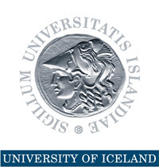
Natural Resource Management: Nordic Lessons on the Path Towards Building a Knowledge-based Economy
Annual conference on The UAE Economic Outlook for 2015 and the Path Towards Building a Knowledge-based Economy organized jointly by the Federal Ministry of the Economy, Department of Economic Development, Government of Dubai, and the Abu Dhabi Department of Economic Development and held in Dubai 16-17 December 2014
Thorvaldur Gylfason

Slide 2
Natural Resources in Nordic Countries
Finland, Iceland, Norway, and Sweden have all benefited from their natural resources
Finland and Sweden outgrew their dependence on natural resources
Norway has managed its oil exceptionally well
Yet, what made the Nordics rich was not so much their natural resources as their use of human capital to harness their natural wealth
Need to diversify by converting natural resources into human resources and social capital

Slide 3
Nordics Benefited from Double Diversity
Economic diversification (acquired)
Spurs growth by attracting economic activity from excessive reliance on primary production in agriculture or natural-resource-based industries
Political diversification (inherited from past)
Spurs growth by redistributing political power from narrowly based ruling elites to the people, often replacing an extended monopoly of power by democracy, encouraging widely shared education
Two sides of same coin: Diversity pays

Slide 4
Evidence: From Economic and Political Diversification to Growth
From Diversification to Growth
Note: Each dot represents a country
From Democracy to Growth
Log of GNI per capita 2012 (USD, ppp)
Manufactures exports 1962-2012 (% of total)
Democracy 1960-2012 (from -10 to 10)

Slide 5
Progress of Democracy
Europe
1943: Five democracies
Now: Full house
Africa
1960-1990: Five or less democracies
Now: 17 democracies
South America (Spanish or Portuguese)
1961: Three democracies out of ten
Now: Eight out of ten

Slide 6
Progress of Diversification
Manufactures exports (% of total)
Source: World Bank, World Development Indicators.

Slide 7
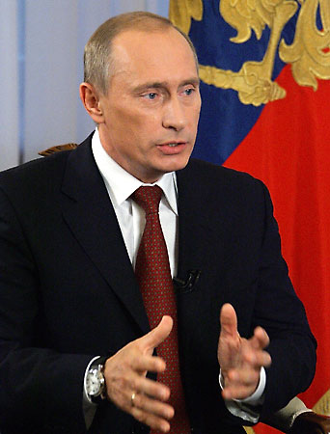
The Risks Are Real
Rent seeking often results in conflict, corruption, economic stagnation, oppression, lack of democracy
Dutch disease through overvalued and volatile currencies tends to stifle exports like undervalued currencies simulate exports (e.g., China)
False sense of security breeds neglect of human resources and social capital via education and institution building, including governance and democracy
“Our country is rich, but our people are poor.”

Slide 8
The Success Stories Are Real, Too
Abundant natural wealth tends sometimes to attract the wrong sort of people to politics
Could list many failures (e.g., Nigeria)
Yet, several countries have done well, e.g.,
Botswana (diamonds)
Malaysia (minerals, timber, gas)
Mauritius (sugar)
Norway (oil)
Gulf countries (oil)

Slide 9
Natural Resources and Human Rights
Natural resources belong to the people
A people’s right to their natural resources is a human right proclaimed in international law and enshrined in many national constitutions
Low taxes and generous transfers and subsidies, even if they amount to only a small fraction of each citizen’s fair share of the nation’s oil wealth, tend to weaken popular demand for democracy

Slide 10
Democracy and Good Governance
Norway was a fully fledged democracy long before its oil discoveries
Oil wealth has never been a source of conflict between haves and have-nots
Norway has no oligarchs
Norway’s Ten oil commandments lay down ethical guidelines for oil wealth management
Good governance can be an effective remedy against rent seeking

Slide 11
Norway’s Ten Oil Commandments
#1 National supervision and control must be ensured for all operations on Norway’s Continental Shelf
#2 Petroleum discoveries must be exploited in a way which makes Norway as independent as possible of others for its supplies of crude oil
#3 New industry will be developed on the basis of petroleum

Slide 12
Norway’s Ten Oil Commandments
#4 The development of an oil industry must take necessary account of existing industrial activities and the protection of nature and the environment
#7 The state must become involved at all appropriate levels and contribute to a coordination of Norwegian interests in Norway’s petroleum industry as well as the creation of an integrated oil community which sets its sights both nationally and internationally

Slide 13
Norway’s Ten Oil Commandments
#8 A state oil company will be established which can look after the government’s commercial interests and pursue appropriate collaboration with domestic and foreign oil interests
#10 Large Norwegian petroleum discoveries could present new tasks for Norway’s foreign policy

Slide 14
Sovereign Wealth Fund
From day one, Norway’s oil and gas reserves were defined by law as common property resources, clearly establishing the legal rights of the Norwegian people to the resource rents
On this legal basis, government has absorbed about 80% of the resource rent over the years
Oil Fund (Pension Fund): USD 850 billion
Managed by independent Central Bank
Norway resisted temptation to use too much of its oil wealth to meet current needs

Slide 15
Step by Step
No one-size-fits-all blueprint is available to guide resource-rich countries to a sustainable path of successful economic diversification toward a knowledge-based economy
No blueprint exists for sequencing of actions
Better, perhaps, to seek path of least resistance and climb the ladder rim by rim
Trade and infrastructure in UAE: State of the art
Need to boost education and institution building
School life expectancy: UAE 13 years vs. Norway 17 years
The end

