Slide 1
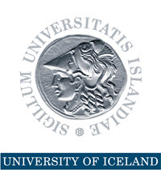
Avoiding the Resource Curse and Consequences for the Financial Sector
MFW4A 2014 PARTNERSHIP FORUM Dakar, Senegal, 10-12 June 2014
Thorvaldur Gylfason

Slide 2
Natural Resources in Nordic Countries
Finland, Iceland, Norway, and Sweden have all benefited from their natural resources
Finland and Sweden outgrew their dependence on natural resources
Norway has managed its oil exceptionally well
Yet, what made the Nordics rich was not so much their natural resources as their use of human capital to harness their natural wealth
Need to diversify by converting natural capital into human capital and social capital

Slide 3
Double Diversification
Economic diversification
Spurs growth by attracting economic activity from excessive reliance on primary production in agriculture or natural-resource-based industries
Political diversification
Spurs growth by redistributing political power from narrowly based ruling elites to the people, often replacing an extended monopoly of sometimes ill-gotten power by democracy
Two sides of same coin: Diversity pays

Slide 4
Evidence: From Economic and Political Diversification to Growth
From Diversification to Growth
Note: Each ball represents a country
From Democracy to Growth
Log of GNI per capita 2012 (USD, ppp)
Export diversification index 1996-2012
Democracy 1960-2012 (from -10 to 10)

Slide 5
From Export Diversification to Growth
Natural capital and diversification
Export diversification and income

Slide 6
From Democracy to Growth
Natural capital and democracy
Democracy and income

Slide 7
Progress of Economic Diversification
2012
Manufactures exports (% of total)
1974
1962

Slide 8
Progress of Political Diversification
Europe
1943: Five democracies
Now: Full house
Africa
1960-1990: Five or less democracies
Now: 17 democracies
South America (Spanish or Portuguese)
1961: Three democracies out of ten
Now: Eight out of ten

Slide 9
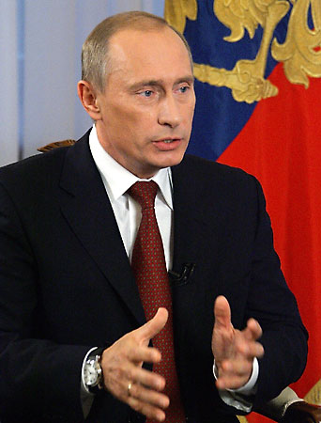
The Risks Are Real
Resource-related rent seeking often results in conflict, corruption, economic stagnation, lack of democracy (clergy, military, royalty)
Dutch disease through overvalued and volatile currencies tends to stifle exports like undervalued currencies simulate exports (e.g., China)
False sense of security breeds neglect of human and social capital through education and institution building, including economic and political diversification
“Our country is rich, but our people are poor.”

Slide 10
The Success Stories Are Real, Too
Abundant natural wealth tends sometimes to attract the wrong sort of people to politics
Could list many failures (e.g., Nigeria)
Yet, several countries have done well, e.g.,
Botswana (diamonds)
Malaysia (minerals, timber, gas)
Mauritius (sugar)
Norway (oil)
Good governance, good institutions

Slide 11
Natural Resources and Human Rights
Natural resources belong to the people
A people’s right to their natural resources is a human right proclaimed in international law, e.g., the International Covenant on Civil and Political Rights, and in many national constitutions
Low taxes and generous transfers and subsidies, even if they amount to only a small fraction of each citizen’s fair share of the nation’s oil wealth, tend to weaken popular demand for democracy

Slide 12
Democracy and Good Governance
Norway was a fully fledged democracy long before its oil discoveries
Democrats are less likely than dictators to try to grab resources to consolidate their political power
Norway’s ten oil ‘commandments,’ adopted before oil production began, lay down ethical guidelines for oil wealth management
Good governance can be an effective remedy against rent seeking

Slide 13
Natural Resources May Undermine Finance
Abundant natural resources may hamper the functioning of the financial system
Dissaving through more rapid resource depletion
Saving through less rapid depletion or more rapid renewal or deposits abroad
Weaker links between domestic savers and investors distort allocation of capital
Lack of financial depth deters efficiency and growth

Slide 14
Sovereign Wealth Funds
From day one, Norway’s oil and gas reserves were defined by law as common property resources, clearly establishing the legal rights of the Norwegian people to the resource rents
On this legal basis, government has absorbed about 80% of the resource rent over the years
Oil Fund (Pension Fund): nearly USD 900 billion
Managed by independent Central Bank
Norway resisted temptation to use too much of the money to meet current needs

Slide 15
Step by Step
Developing countries with pressing economic and social needs cannot be expected to show the same patience as Norway
No one-size-fits-all blueprint is available to guide resource-rich countries to a sustainable path of successful economic diversification
Seek path of least resistance, doing easy things first, climbing the ladder rim by rim
Boost education, infrastructure, and institution building, including good governance
The end

