Slide 1
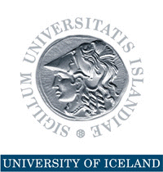
Political Economy, Mr. Churchill, and Natural Resources
Presentation at the
25th IPSA World Congress of Political Science
in Brisbane, Australia, 21-25 July 2018.
Thorvaldur Gylfason

Slide 2
Outline
Economists and Politics
Churchill in Africa
  United States, Norway, Russia, and others
  Angola: Then nothing is wrong
  Cross-country evidence
Natural Resources and Human Rights
  The state or the people?
  Distributive options
  Democracy under stress
Conclusion

Slide 3
From Lee Kuan Yew to Jeffrey Sachs
Sometimes political leaders are more prescient than their economic advisers or academic contemporaries
Lee Kuan Yew, founding father of Singapore (1959-1991):
  “I thought then that wealth depended mainly on the possession of territory and natural resources .... It was only after I had been in office for some years that I recognized that … the decisive factors were the people, their natural abilities, education and training.”
  Years later Sachs and Warner noticed that some countries have grown disappointingly slowly for reasons having to do with their mismanaged dependence on their natural resources

Slide 4
Two Main Aims
Recall Winston Churchill´s 1908 conclusion about Uganda and its natural resources
Discuss the management and macroeconomic impact of oil and other natural resources in terms of constitutions, human rights, and democracy …
  … aspects that are grounded in law and political economy often overlooked by economists and governments preoccupied by economics
  Empirical evidence of the cross-country relationship between economic and political diversification – i.e., democracy – and economic performance will not be presented here to save time

Slide 5
What Churchill Said in 1908
“All this waterpower belongs to the State. Ought it ever to be surrendered to private persons?
… in Uganda the arguments for the State ownership and employment of the natural resources of the country seem to present themselves in their strongest and most formidable array.
… the profits will not go to the Government and people of Uganda, to be used in fostering new industries, but to diverse persons across the sea, who have no concern, other than purely commercial, in its fortunes.”
My African Journey, 1908

Slide 6
Norway Paid Attention I
Norwegian government understood this fully from the outset
Oil within Norway´s jurisdiction is defined by law as the property of the state
  No significant rent seeking took place
  Oil barons and oligarchs are few and far between in Norway; the terms hardly exist in the country´s political vocabulary
This is in sharp contrast to Iceland next door where “sea barons” and “quota kings” have been ubiquitous in political discourse since the mid-1980s, like “oligarchs” in Russia

Slide 7
Norway Paid Attention II
The Norwegian people, through their government, have managed to keep 80% of the oil rent, most of it in a Pension Fund that is, at more than $1 trillion, or $800,000 for every family of four, by now the world´s largest Sovereign Wealth Fund
Norway avoided the dangers that Mr. Churchill feared in Uganda
Norway´s political culture proved mature enough that no detailed protection in the constitution against private expropriation of the oil wealth, domestic or foreign, has been considered necessary

Slide 8
Constitutions
Constitution makers increasingly view natural resources as common property resources that belong to the state on behalf of the people or to the people directly
  Russian constitution: “The land and other natural resources may be in private, state, municipal and other forms of ownership.”
  Ugandan constitution: “All minerals and petroleum in Uganda are held by the Government on behalf of the people of Uganda.”
  Icelandic constitution bill from 2011: “Iceland’s natural resources which are not in private ownership are the common and perpetual property of the nation.”

Slide 9
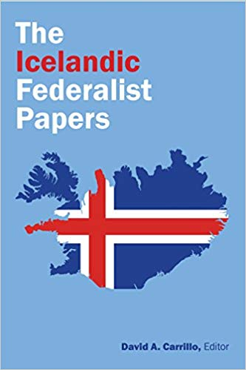
New Book From Berkeley
Collection of 21 essays written by an international team of scholars (all using the pseudonym Civis) that analyzes arguments for and against the proposed new constitution written by the Constitutional Council elected by the nation and appointed by parliament. Also, the collection analyzes the defects in Iceland´s present constitution and explains the benefits of the proposed new constitution that won support by 67% of the voters in a national referendum in 2012.

Slide 10
The State or the People?
By international law, the property rights to natural resources belong to the people
Article 1 of the International Covenant on Civil and Political Rights (ICCPR) states that
“All people may, for their own ends, freely dispose of their natural wealth and resources.”
  Violations of this principle can be referred to foreign courts
  In 2007, the UNHRC declared discriminatory allocation of fishing quotas in Iceland to constitute a violation of human rights
    The constitution bill from 2011 removes the discrimination at issue

Slide 11
State Ownership vs. National Ownership
State ownership (e.g., public office buildings) means that the state can sell or pledge such assets at will
National ownership (e.g., cultural assets like the Hermitage or natural assets like energy) means that the state cannot sell or pledge such assets because they are considered invaluable and irreplaceable
Losing them would violate the rights of the current generation’s descendants who might later realize that their parents had plundered the nation’s common heritage

Slide 12
The Importance of Democracy
The key to the human rights perspective on natural resources and their management is democracy and the rule of law
The crucial difference between the US and, say, Angola or Equatorial Guinea is that, under democracy, US citizens are not defenseless against their government’s natural resource management practices, and never were
In Angola and Equatorial Guinea, by contrast, the lack of democracy and disrespect for human rights and rule of law leave ordinary citizens virtually defenseless against the usurpation by governing elites of the people´s natural resource wealth and the rents it generates

Slide 13
Law, Politics, and Economics I
Natural resources belong to the people as a matter of almost universally acknowledged international human rights
The plundering of natural resources, even when permitted by local laws, violates international human rights covenants that supersede national laws
This is why natural resource management is a legal concern as well as an economic and political one
  An this is why some suggest that the most extreme offenders be taken to international court

Slide 14
Law, Politics, and Economics II
This is what Winston Churchill must have been thinking when he spoke up for state ownership of natural resources in Uganda in 1908, the prevalent arrangement in today´s world
And this is why national constitutions increasingly define natural resources as a common property belonging to the state on behalf of the people if not to the people directly
Even so, in many countries state ownership by law has not sufficed to secure the right of the people to the rents from their resources

Slide 15
Conclusion
This is why national ownership is needed, anchored as it already is in international bills of human rights
And this is why national ownership rather than state ownership or other forms of ownership needs to be anchored also in national constitutions …
… and also why it helps to promote peoples´ rights to the rents from their natural resources as well as their individual freedom from discrimination as a matter of human rights to further strengthen the civil rights of ordinary people against self-dealing elites
The End

