Slide 1
ICELAND´S NEW CONSTITUTION IS
NOT SOLELY A LOCAL CONCERN
Thorvaldur Gylfason
University of Iceland
For 83rd International
Atlantic Economic Conference,
Berlin, 22-25 March 2017

Slide 2
Iceland: More Political than Economy
Local piece, in six parts, with potential lessons for other countries
  Democracy under stress
  Iceland´s 1944 constitution
  New post-crash constitution
  Political dysfunction
  Human rights
  Current impasse

Slide 3
Democracy under Stress
1849: One democracy, US
1918-1939: 25 democracies
1943: 5 democracies in Europe
  UK, Ireland, Iceland, Sweden, Switzerland
1960: 35 democracies
2000: 90 democracies, almost half of total
2000 to date: No increase
  Hungary, Poland within EU; even US, which brings us to Iceland

Slide 4
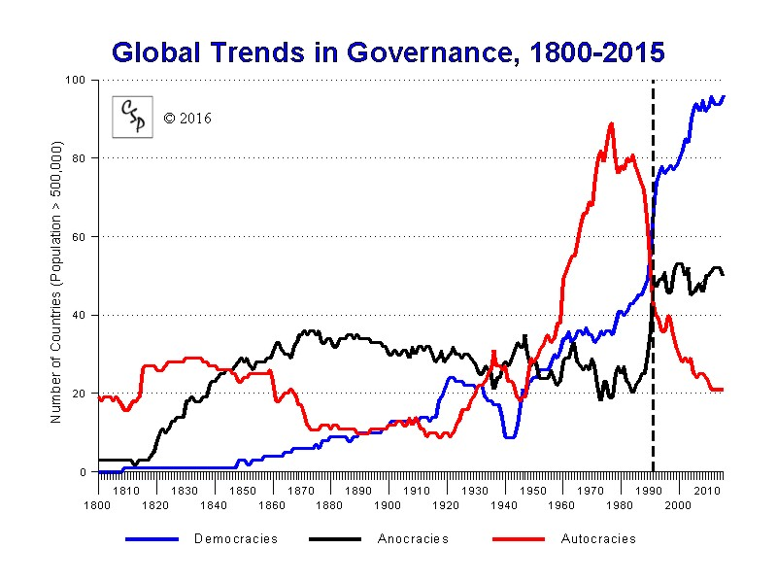
Number of Democracies
Source: Policy IV Project.

Slide 5
Democracy under Stress
Imagine that UK Parliament had decided to ignore the Brexit vote, pretending it did not take place
  Unthinkable, right?
This is what Icelandic Parliament has done since 2012 when Iceland held constitutional referendum where 2/3 of voters declared support for new post-crash constitution bill
  Affront to democracy, some say “putsch”
  Unfortunate timing, with democracy under duress

Slide 6
Iceland´s 1944 Constitution
Iceland declared independence from Nazi-occupied Denmark in 1944, adopting provisional constitution
  Translation of Denmark´s 1849 constitution except
    King replaced by President, directly elected by nation
    Parliament wanted to select President, but was overruled
  Deeply flawed, unfit for a modern republic
    2016 presidential election
    Unequal voting rights: Votes in rural areas weigh up to twice as much as votes in urban areas, creating rural bias
    Discriminatory fisheries management: Oligarchs

Slide 7
New Constitution
New constitution fixes all these issues, and more
Most democratic, inclusive constitution ever drafted
  National Assembly, 950 individuals drawn at random from adult population
  Constituent Assembly, directly elected by the people, passed its bill unanimously, 25 to 0
  National referendum in 2012
    2/3 said Yes to constitution as a whole
    2/3 said Yes to equal voting rights
    5/6 said Yes to national ownership of natural resources

Slide 8
Political Dysfunction
Parliament launched reform project after 2008 crash, then turned its back on it as IMF-supported economic rescue operation began to produce good results
Politicians dress up their objections in legalese
However, their real reasons are obvious
  Some could not be reelected under “one person, one vote”
  Some dare not challenge oligarchs
  Some view constitution as their turf

Slide 9
Political Dysfunction
Politicians are unfit to be constitution makers
  Risk of self-dealing is real
Public trust in Parliament is low
  Down from 41% 1995-2007 to 15% 2008-2016 (Gallup)
  Common figure in Europe is 33%
Western Europe had 332 ministers in 2016
  4 showed up in Panama papers, thereof 3 Icelanders
  All 3 ran for reelection in 2017, and won

Slide 10
Human Rights
Is Parliament´s failure to respect result of 2012 constitutional referendum solely a local issue?
No, because inalienable human rights are involved
  Foreign election observers, including OSCE, have declared unequal voting rights in Iceland to constitute violation of human rights
  UNHRC has declared discriminatory allocation of fishing quotas to constitute violation of human rights
Such violations can be referred to foreign courts

Slide 11
Current Impasse
Parliament promised new constitution in 1944 to replace the provisional one, but did not deliver
In 2013-2016 Parliament tried once more as if no referendum had taken place, and failed again
  Parliament prepared and then gave up on watered-down versions of three provisions out of 114, including one on natural resources designed to please the oligarchs
“The outcome is what the reactionaries can accept”
  -- said member of the committee involved

Slide 12
Conclusion
Remember US Constitutional Convention in 1787
Congress made no changes, referring bill to 13 states for ratification
  After 9 states had passed bill, some with slender margins, it became law
  Process of amending bill started almost immediately
If Parliament persists in its misbehavior, Iceland may stray farther toward cluster of countries where democracy is under greatest stress

